Slide 1
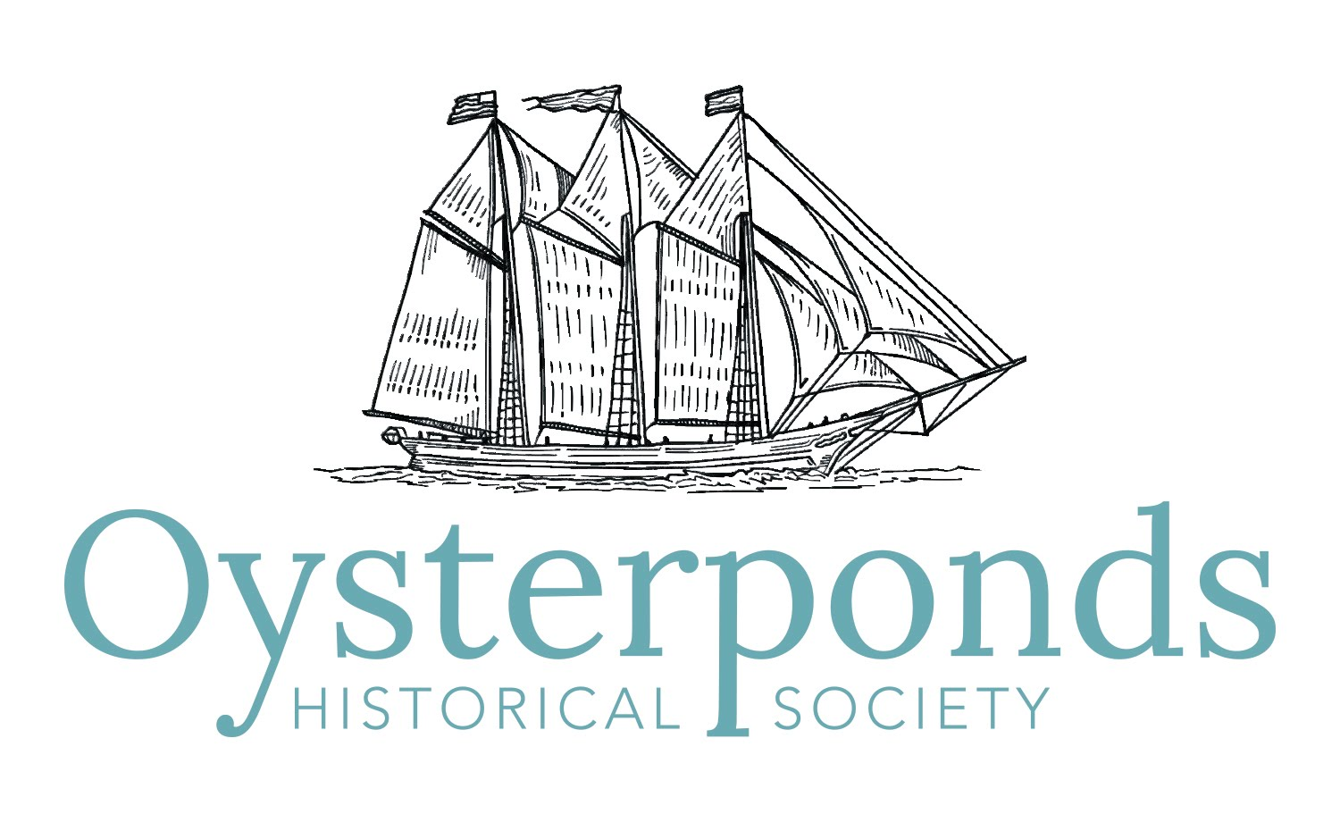
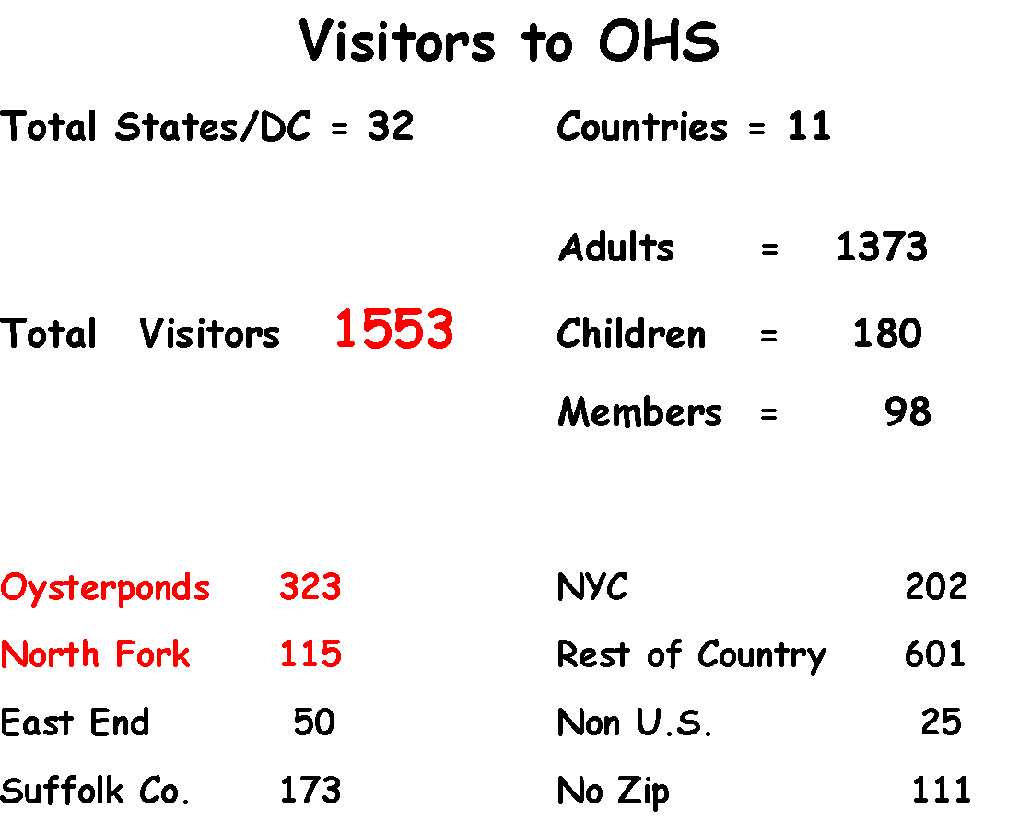
Annual Membership Meeting
November 16, 2019
Thank You for an Amazing 75th Year
The Oysterponds Historical Society celebrates and shares North Fork culture and heritage by preserving, exhibiting and interpreting the history of the Orient and East Marion communities, and our place in national history.

Slide 2
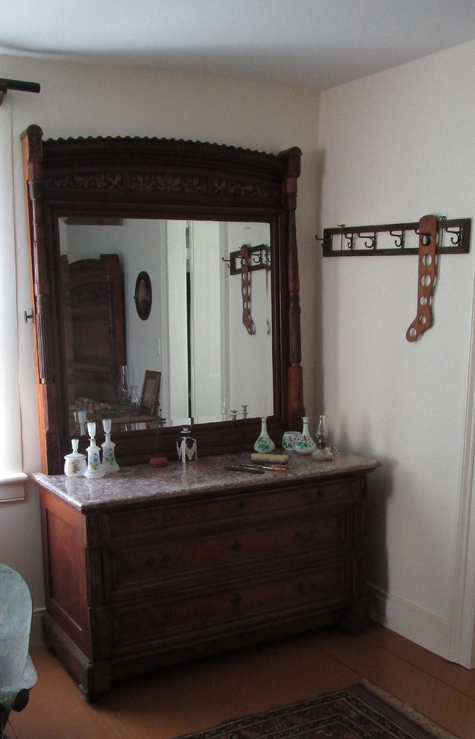
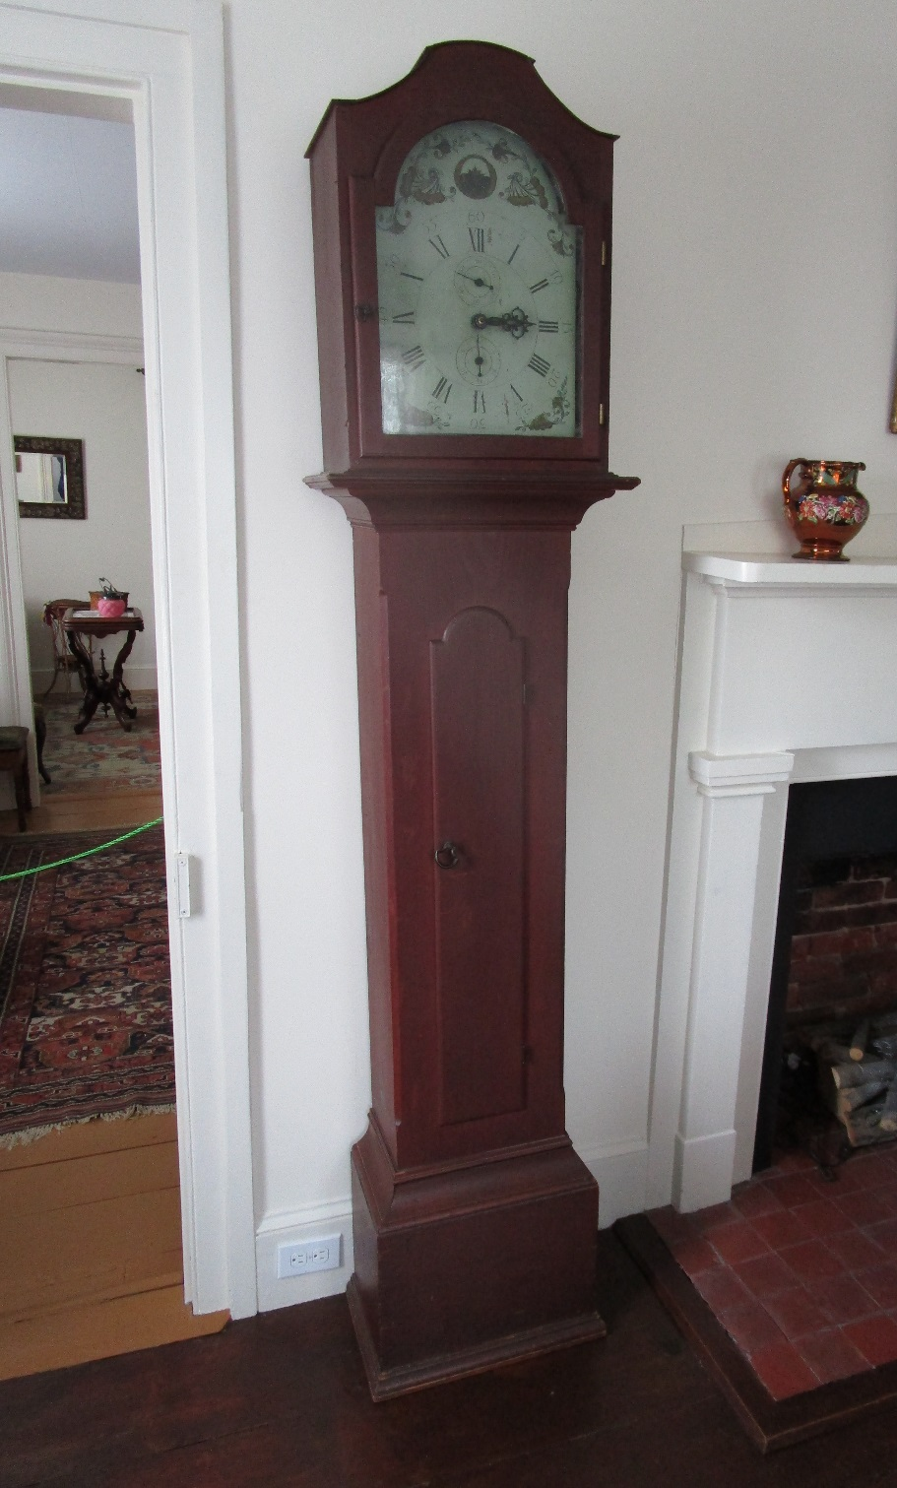
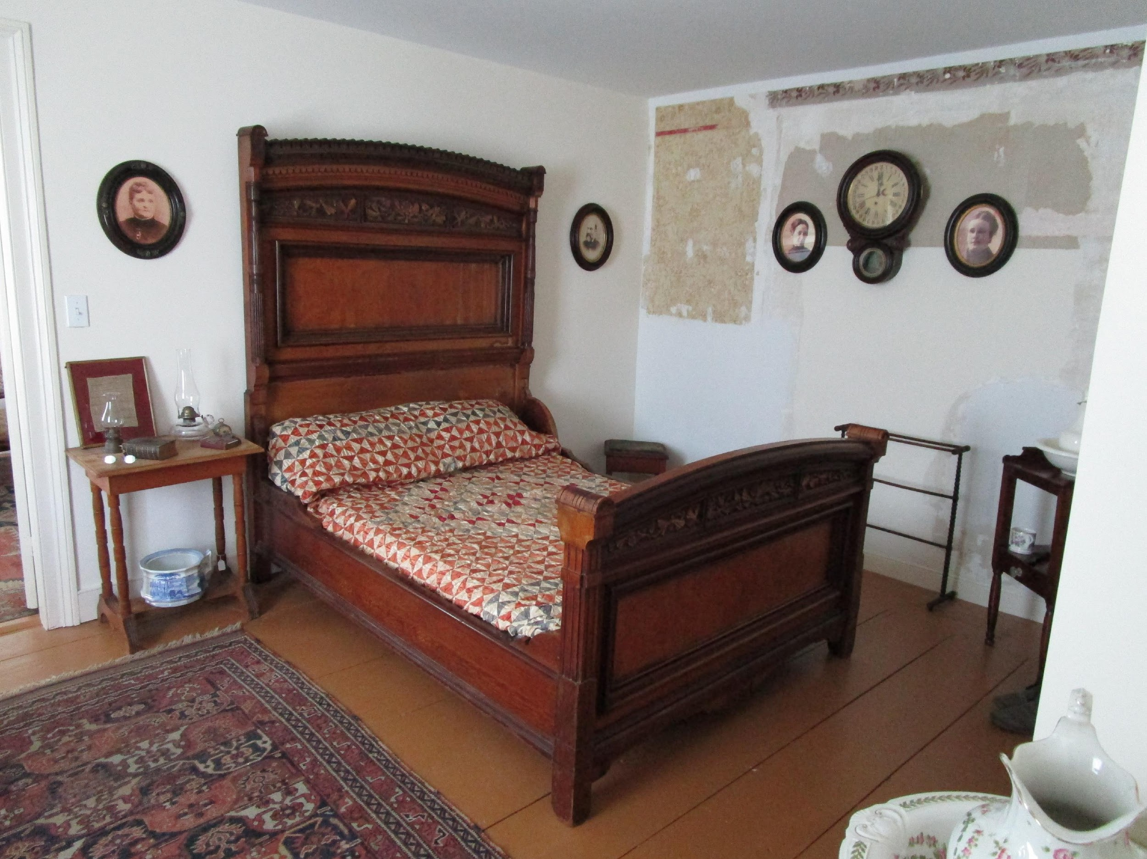
Advancing Our Mission:
Acquisitions
Advancing Our Mission:
Acquisitions
A
Annual
42 Accessions, 416 Items
The Dwight Family of Arm and Hammer fame built their summer home in Orient around 1906. Their bed and dresser are from the aesthetic movement, and are the perfect time period for Village House.
An 1808 Eli Terry tall-case clock, acquired by OHS in June. It was owned by an Orient resident. The clock is one of the earliest examples of the budding industrial revolution in America. This clock is one of ten (out of 4,000 made) that survives.

Slide 3
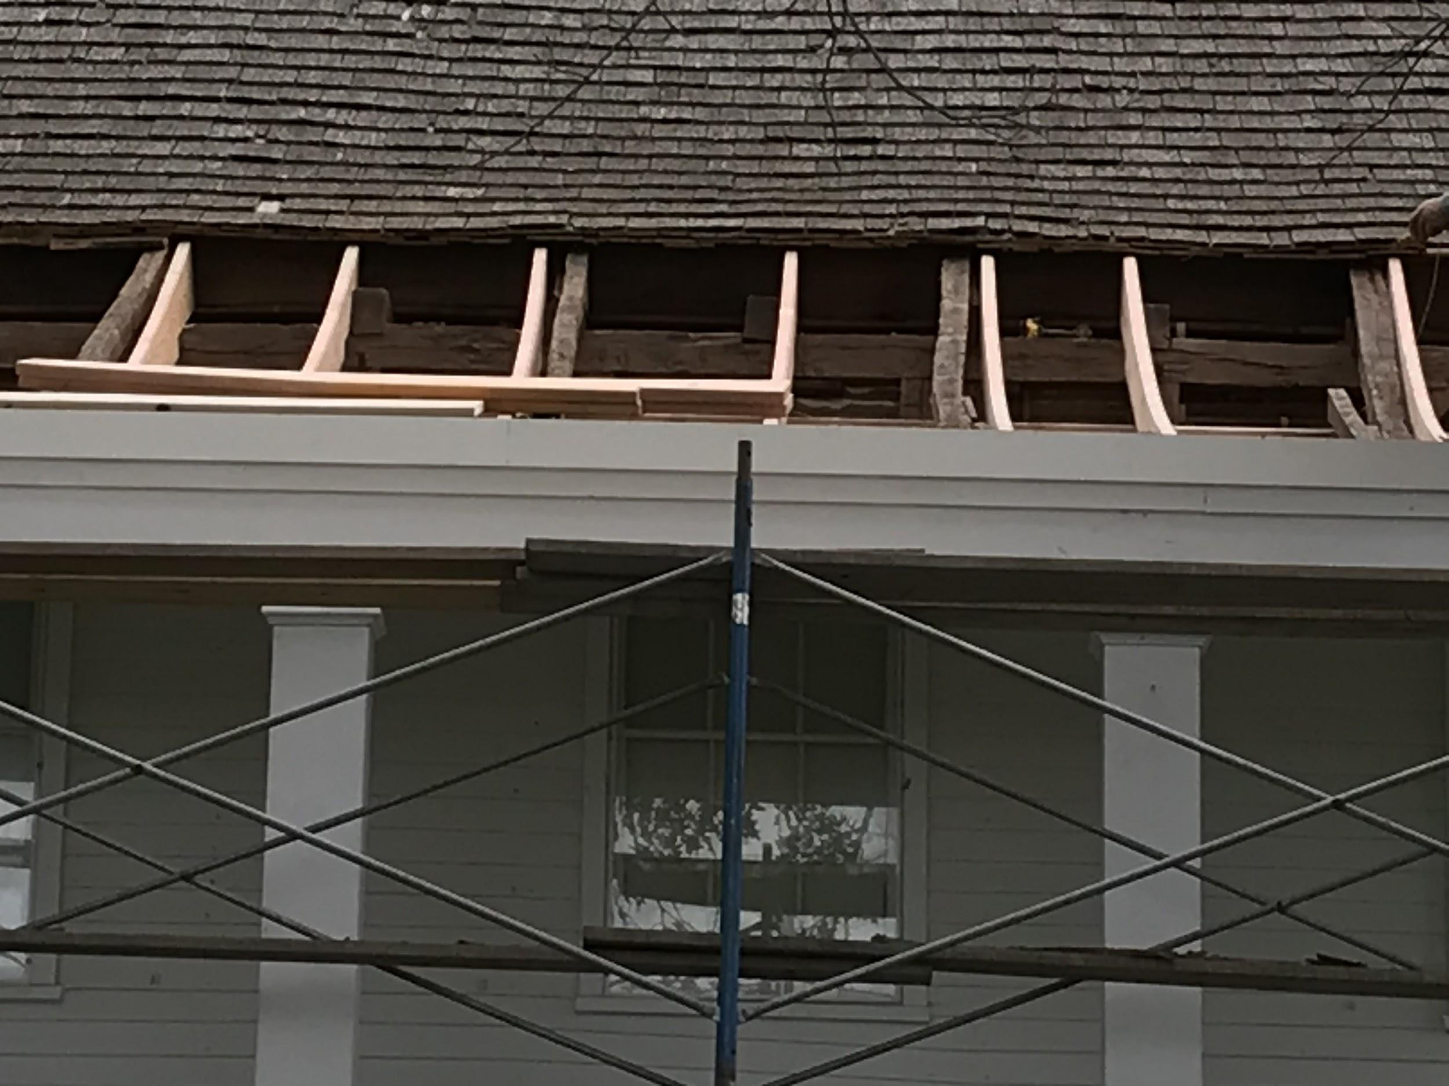
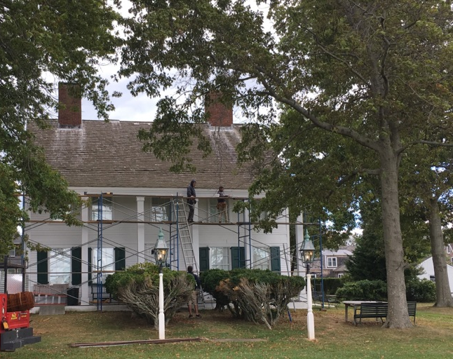
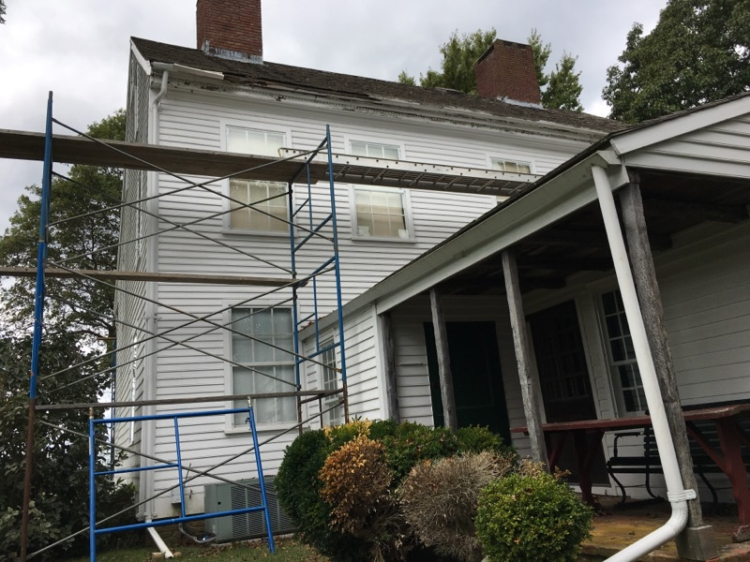
Advancing Our Mission:
Acquisitions
Advancing Our Mission:
Preservation
A
Annual
Much-needed Roof Renovations were completed at Webb House

Slide 4
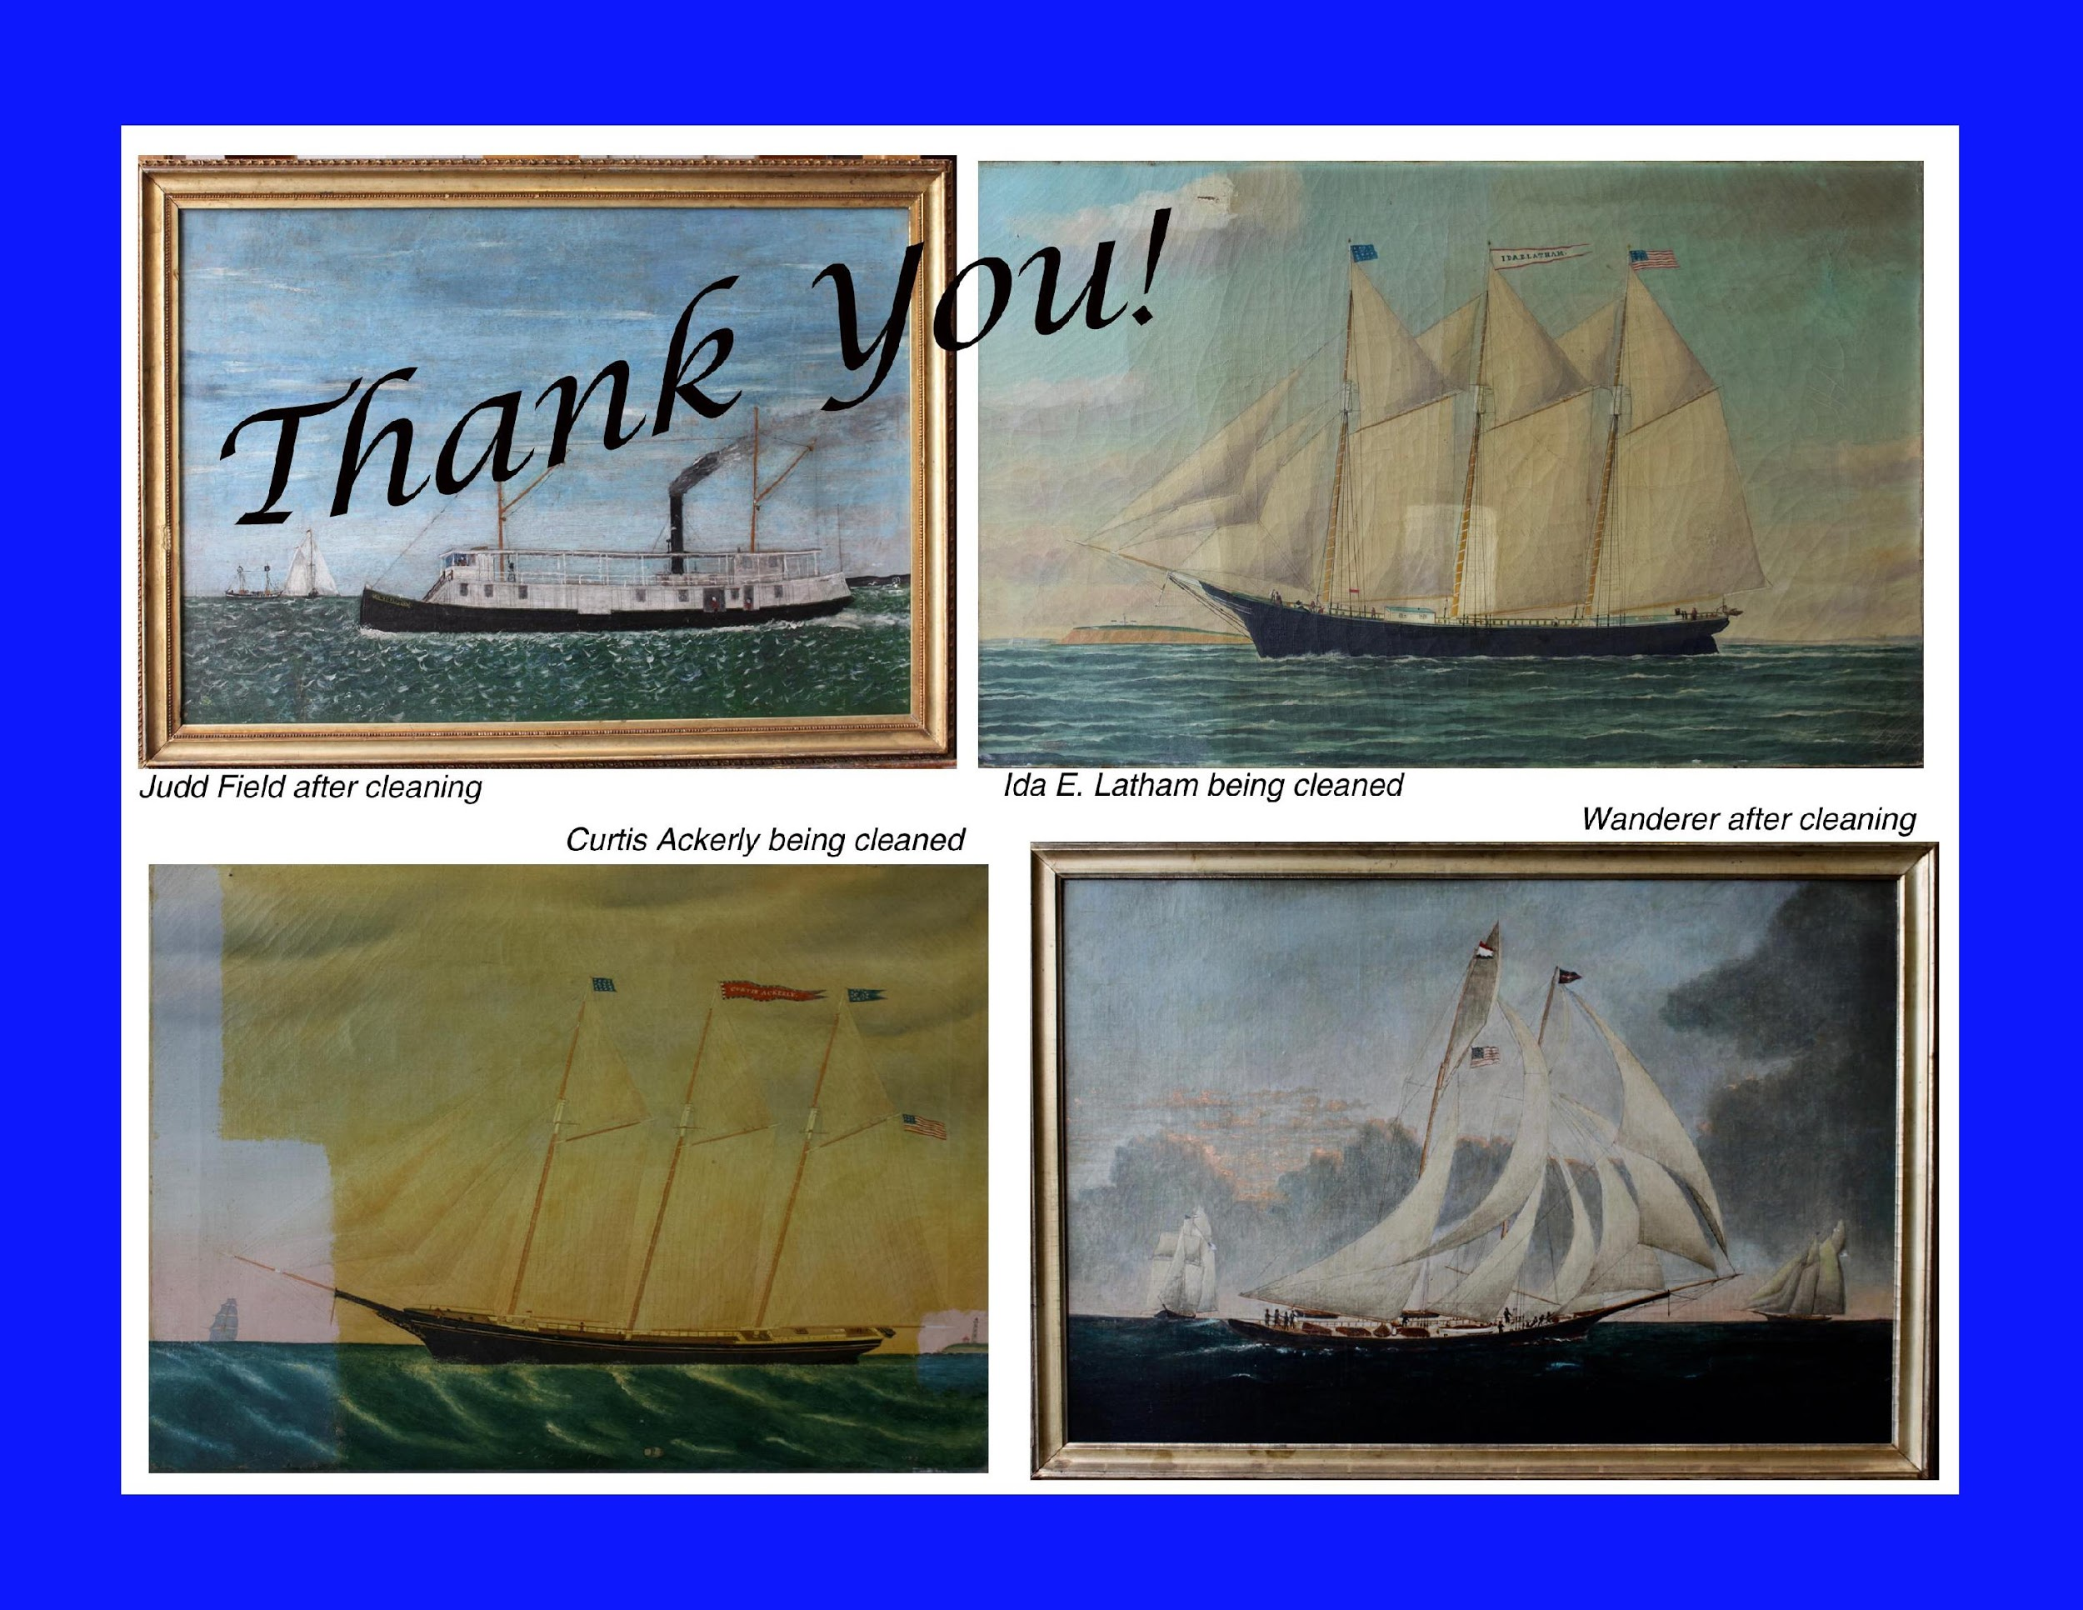
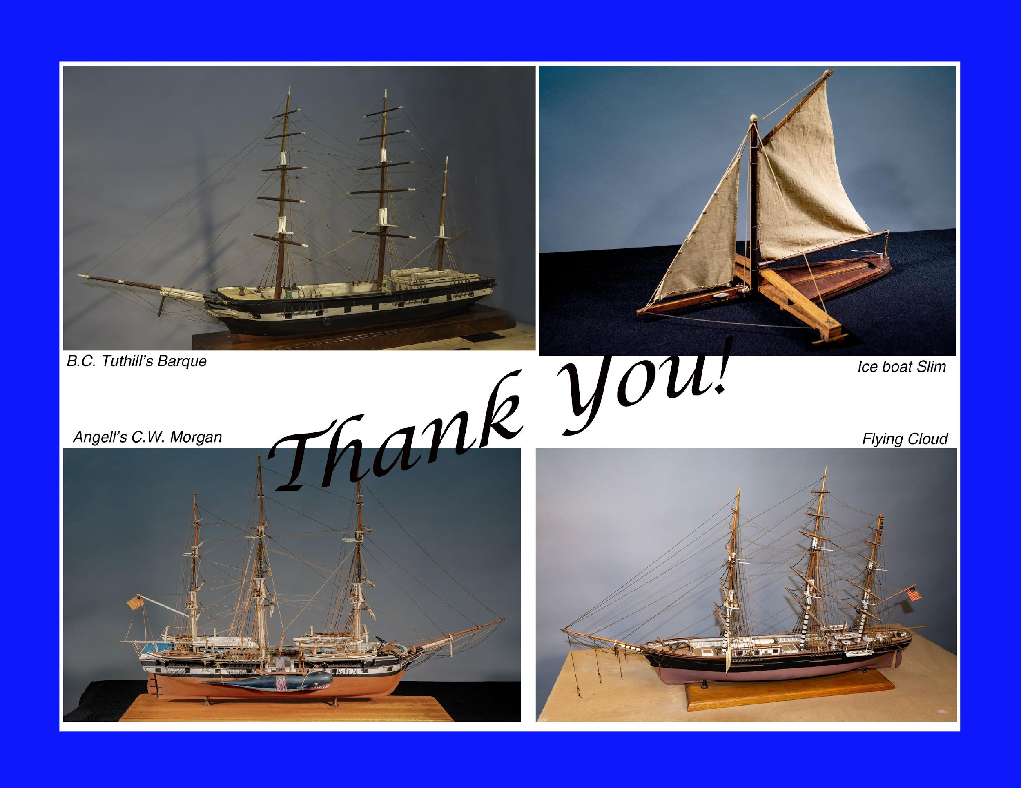
Advancing Our Mission:
Acquisitions
Advancing Our Mission:
Preservation
A
Annual
Four ship models and seven paintings were restored with the generous donations to the Maritime Collection Conservation Fund.

Slide 5

Advancing Our Mission:
Acquisitions
Advancing Our Mission:
Collections Care
A
Annual
The OYSTERPONDS HISTORICAL SOCIETY
Collections Care Plan was completed by Jan Hird Pokorny Associates and Rainey Tisdale in May 2019.
It was funded by a generous grant of $53,330 from the Robert David Lion Gardiner Foundation and was completed in May, 2019.
The Collections Care Task Force will soon begin the process of evaluating and implementing options for storage and care that will preserve our collection for the future.

Slide 6
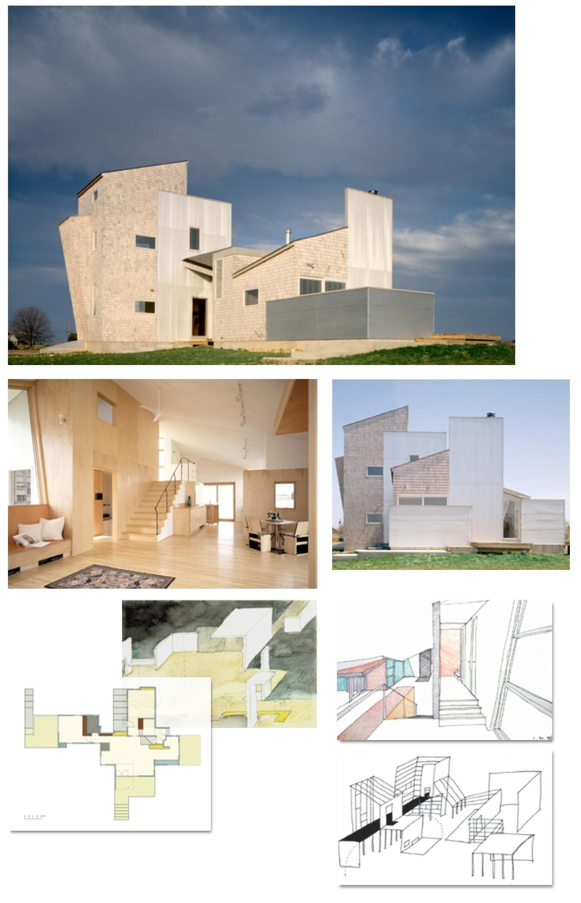
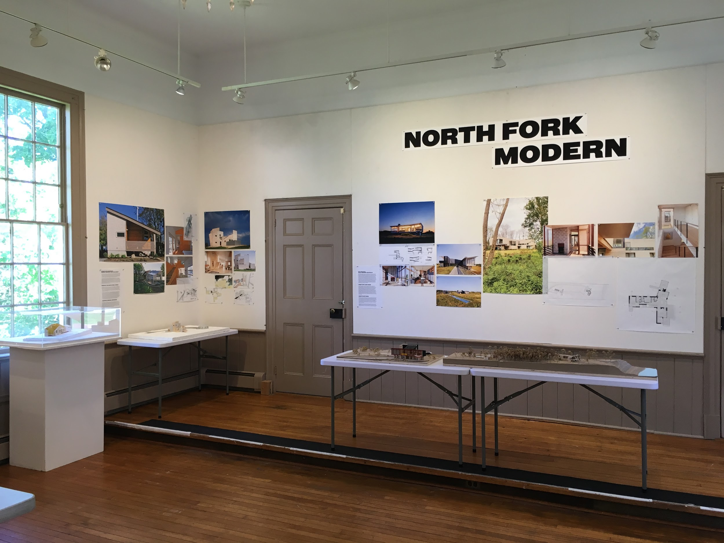
Advancing Our Mission:
Acquisitions
Advancing Our Mission:
Exhibits
A
Annual
Our Featured Exhibit in the Janet T. Swanson Gallery at the Old Point Schoolhouse
“New Wave of Architecture on the North Fork” was guest curated by renowned modern architect and architectural historian, Barry Bergdoll, Meyer Schapiro Professor of Art History at Columbia University

Slide 7
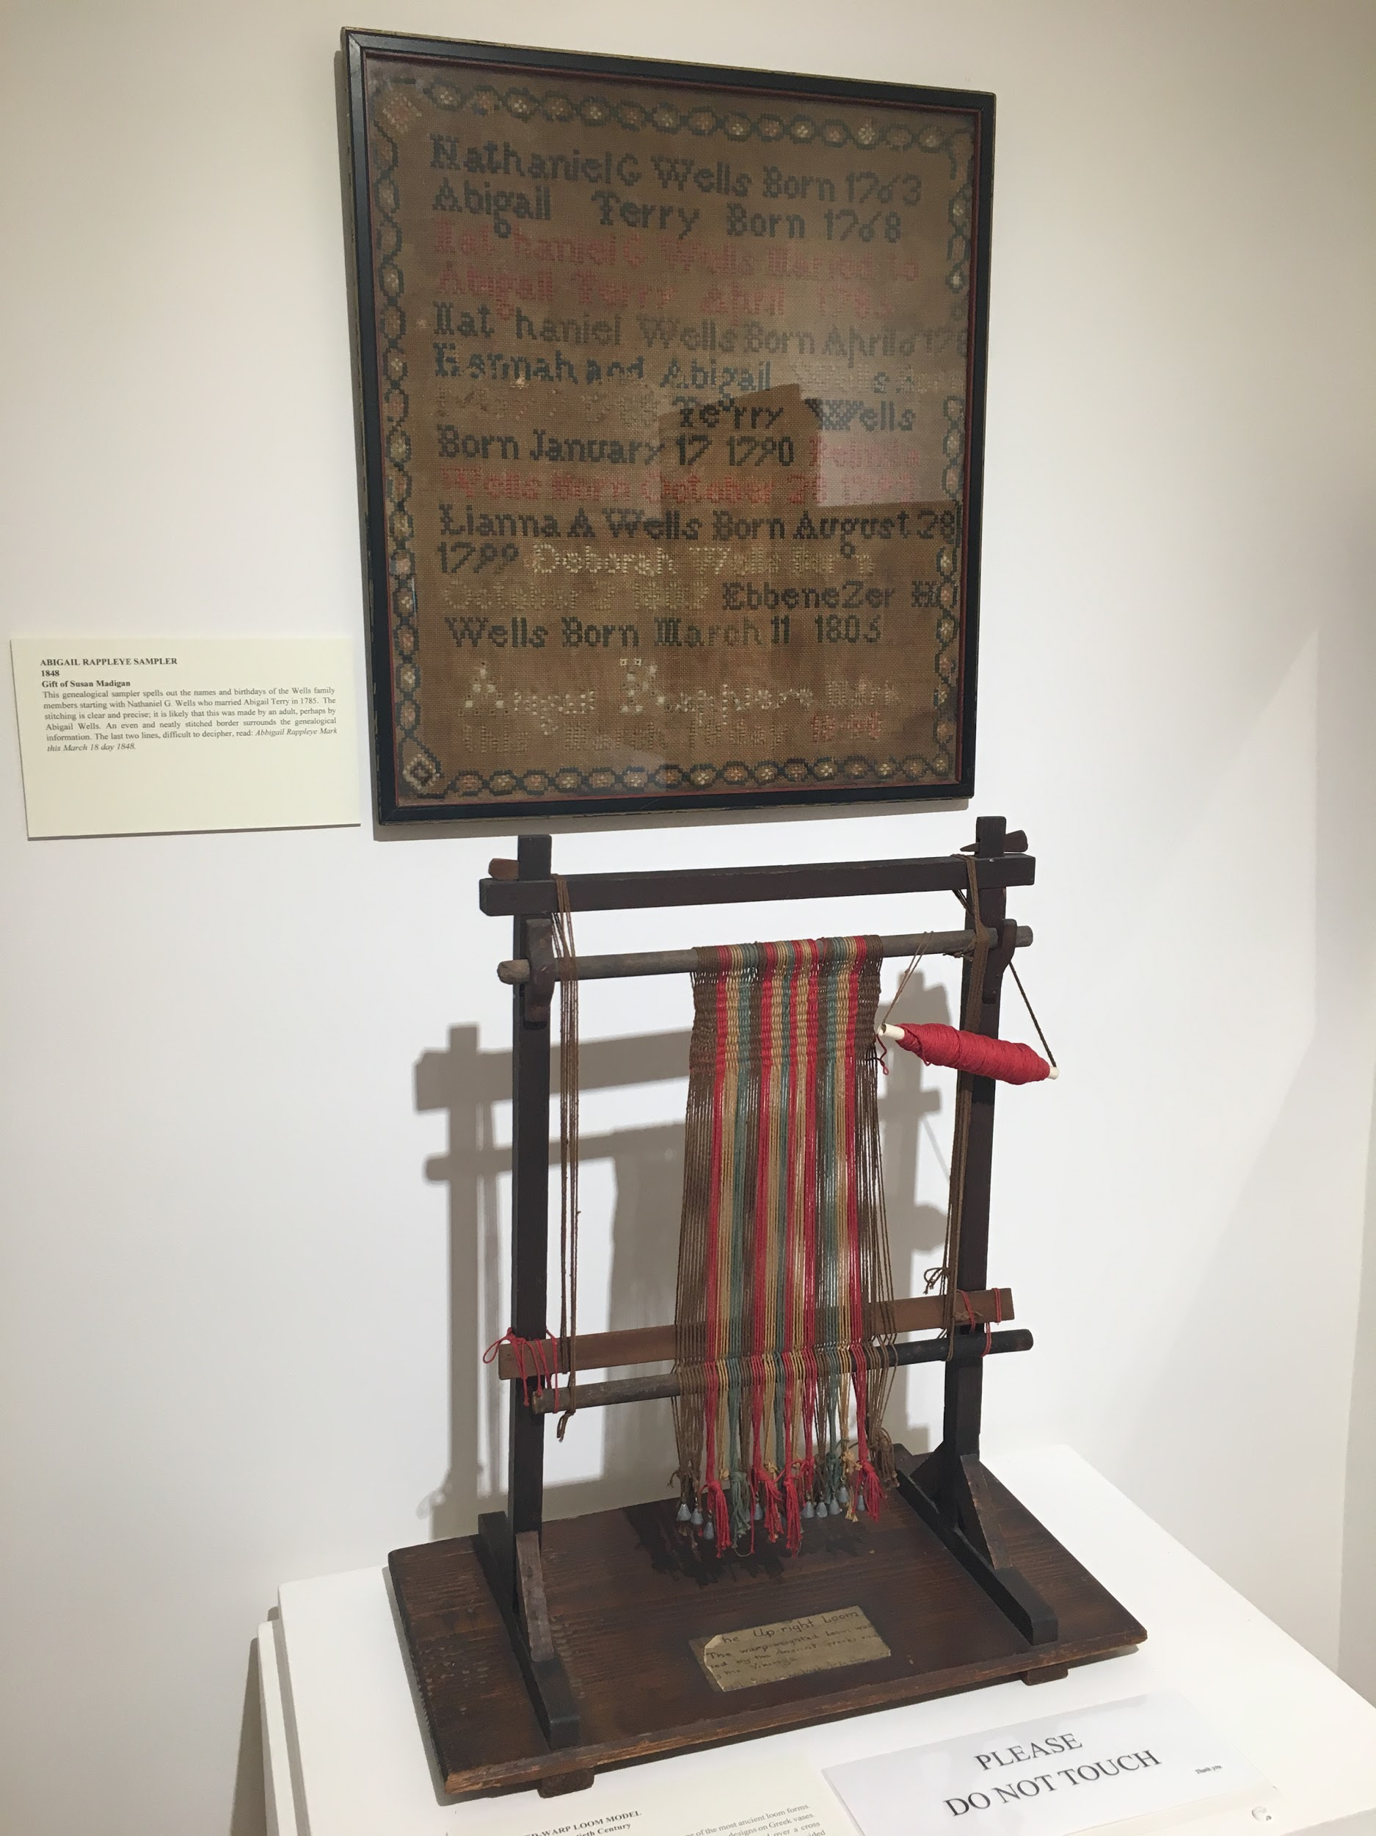
Advancing Our Mission:
Acquisitions
Advancing Our Mission:
Exhibits
A
Annual
Village House Exhibitions
Curated by Bill McNaught
Oysterponds in The Civil War
Miniature Looms and Samplers
Maritime Paintings
L. Vinton Richard: Early Photographs
Weapons
75th Anniversary of OHS

Slide 8
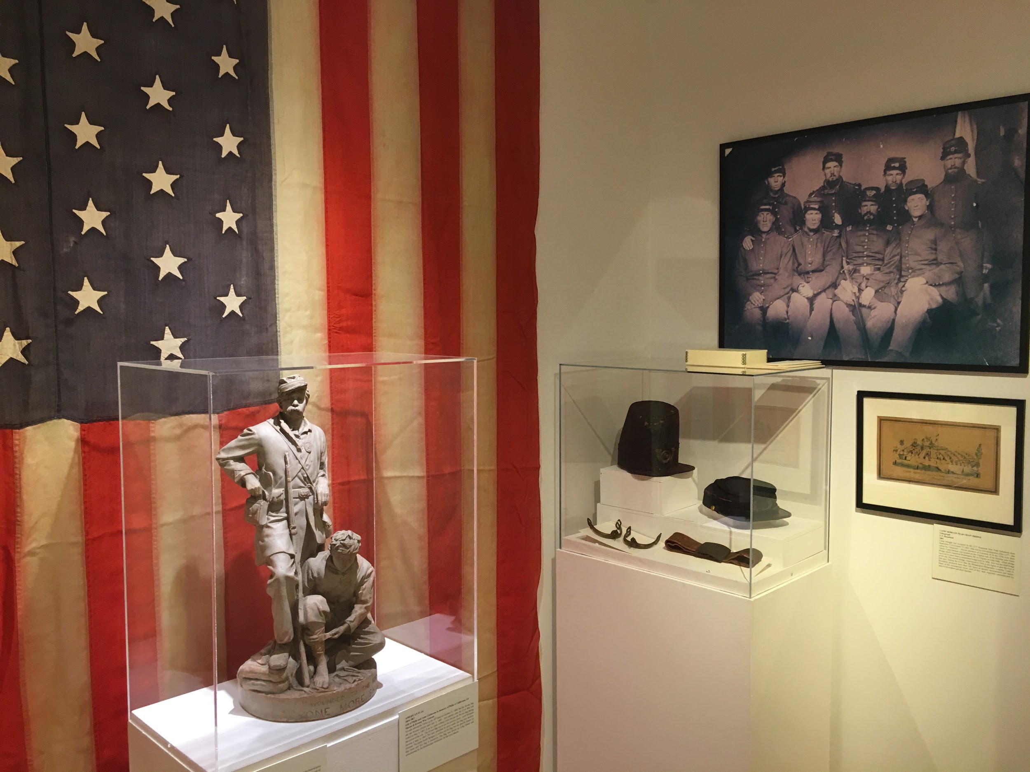
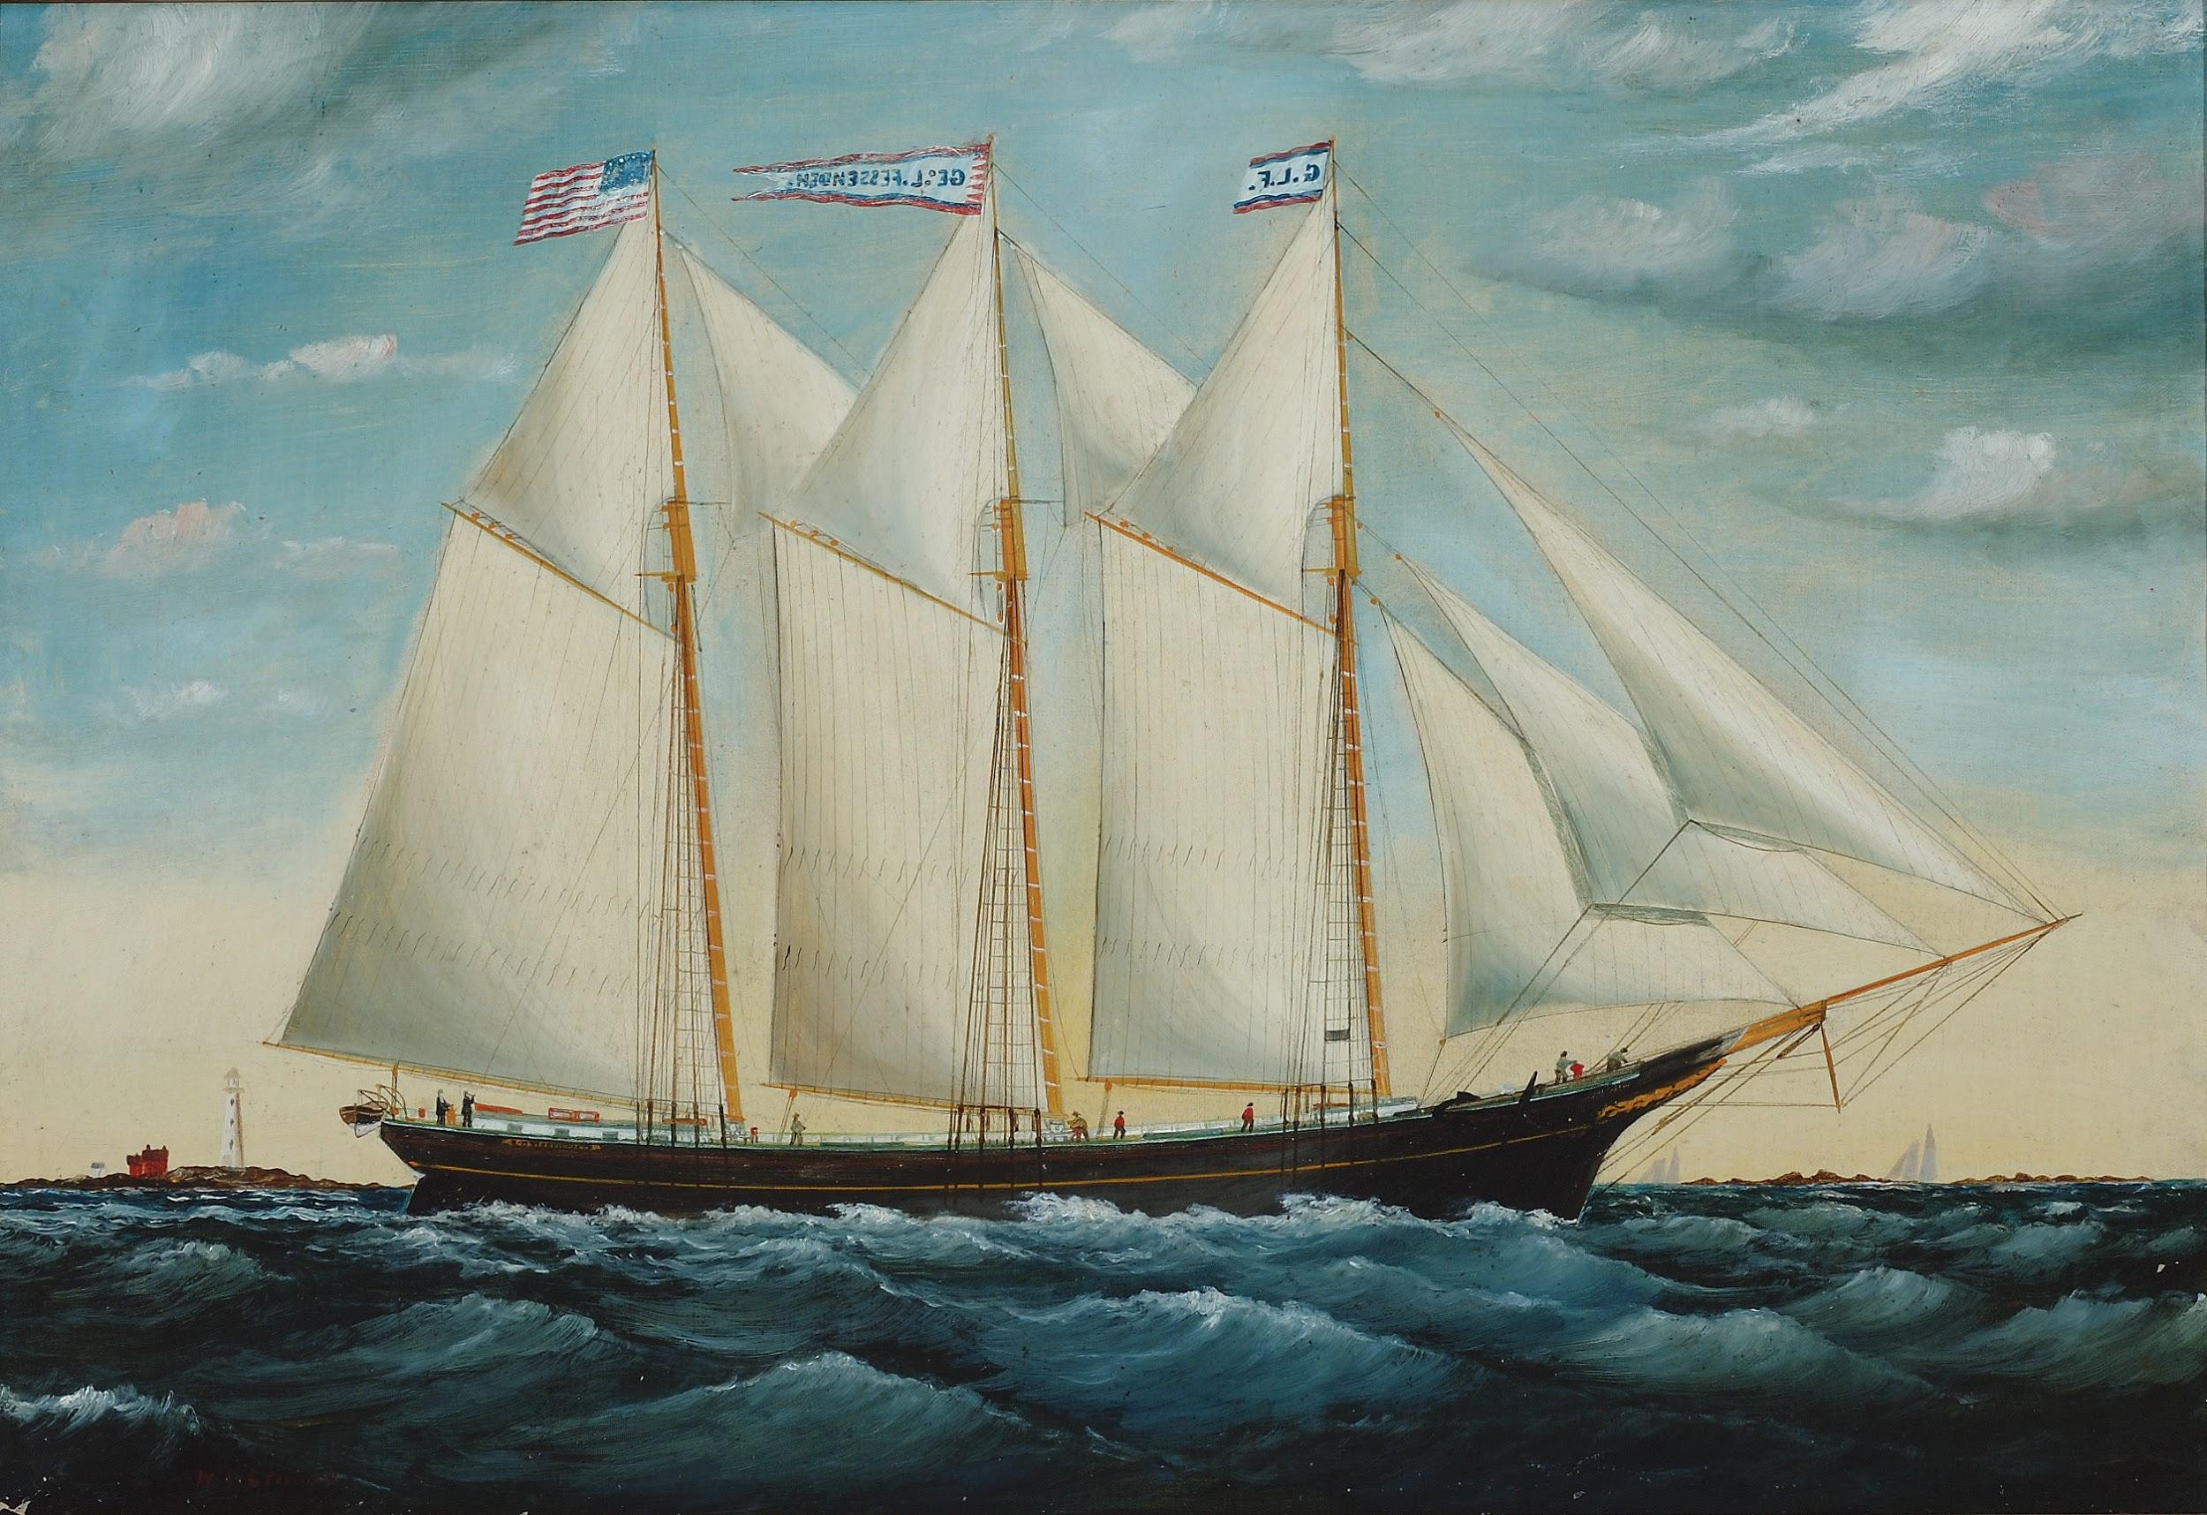
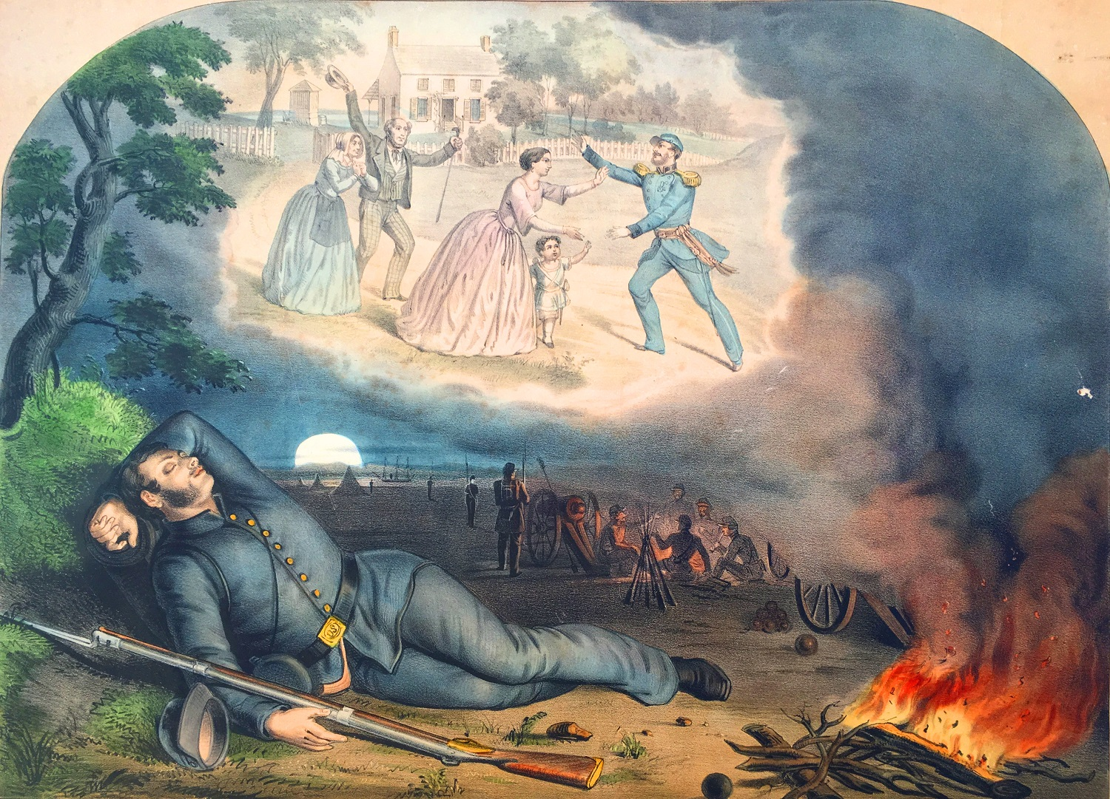
Advancing Our Mission:
Acquisitions
Advancing Our Mission:
Exhibits
A
Annual

Slide 9
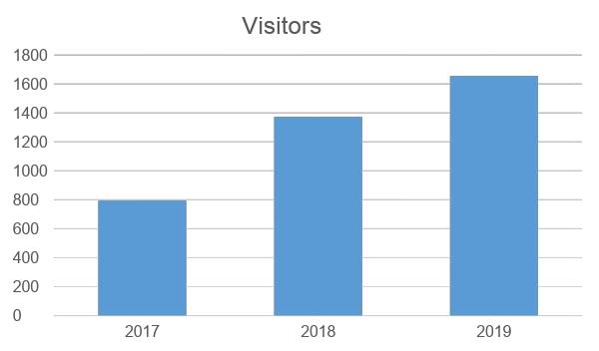
Advancing Our Mission:
Acquisitions
Advancing Our Mission:
Exhibits
A
Annual

Slide 10
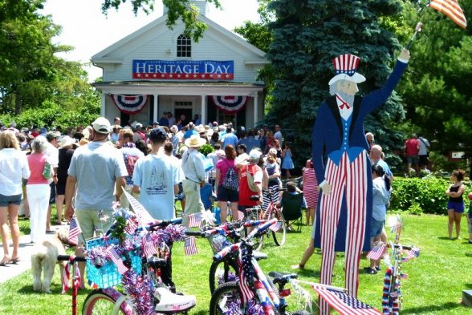
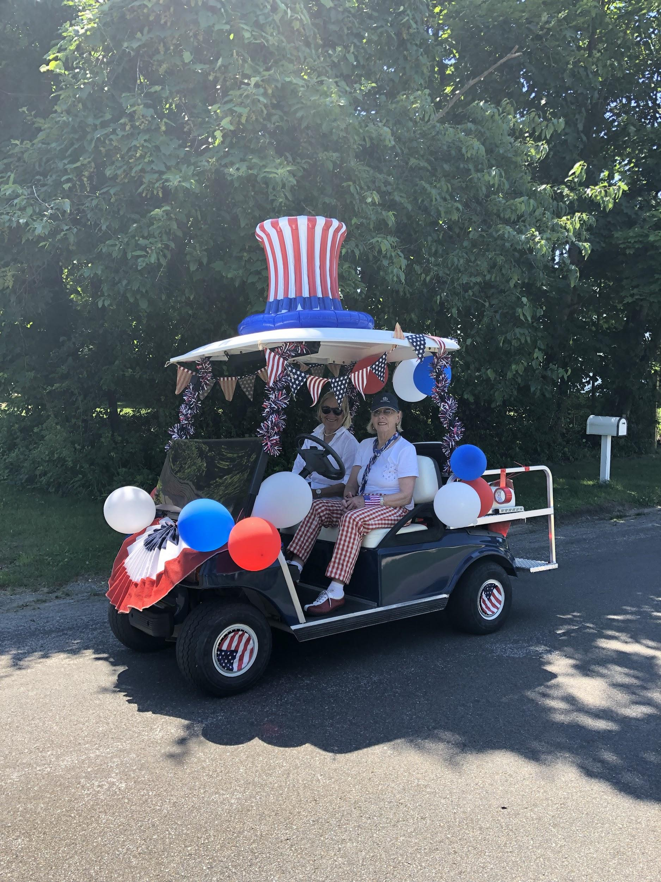
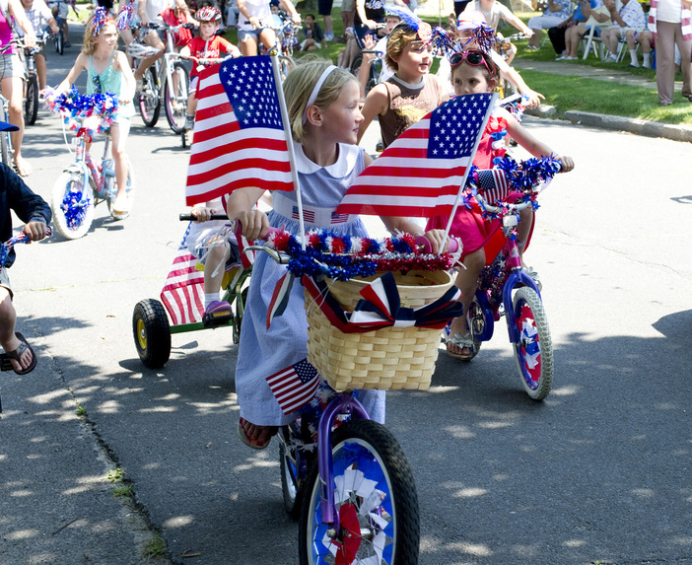
Advancing Our Mission:
Acquisitions
Advancing Our Mission:
Education & Programs
A
Annual
Heritage Day 400 guests

Slide 11
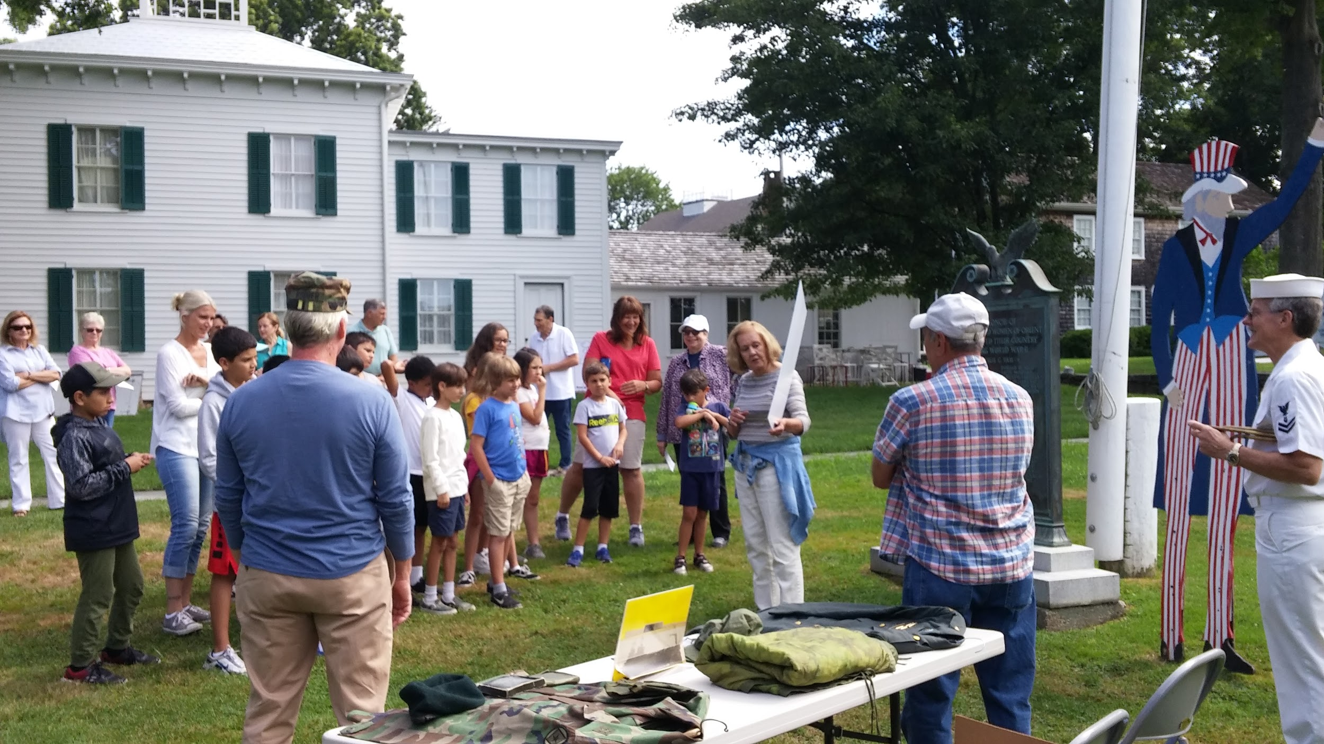
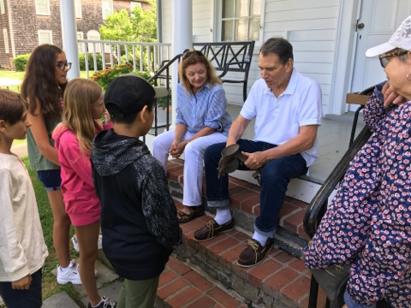
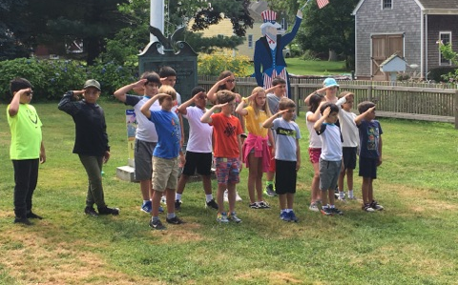
Advancing Our Mission:
Acquisitions
Advancing Our Mission:
Education & Programs
A
Annual
Oysterponds Summer Camp Program: Celebrations
Campers learned about the OHS tradition of honoring Veterans, guessed the use for objects in our collection and enjoyed a birthday cake in celebration of the OHS 75th anniversary.

Slide 12
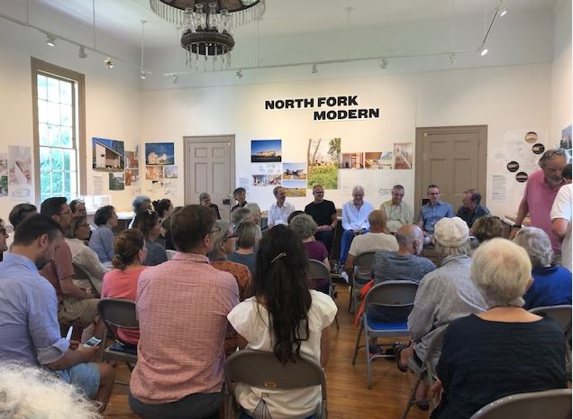
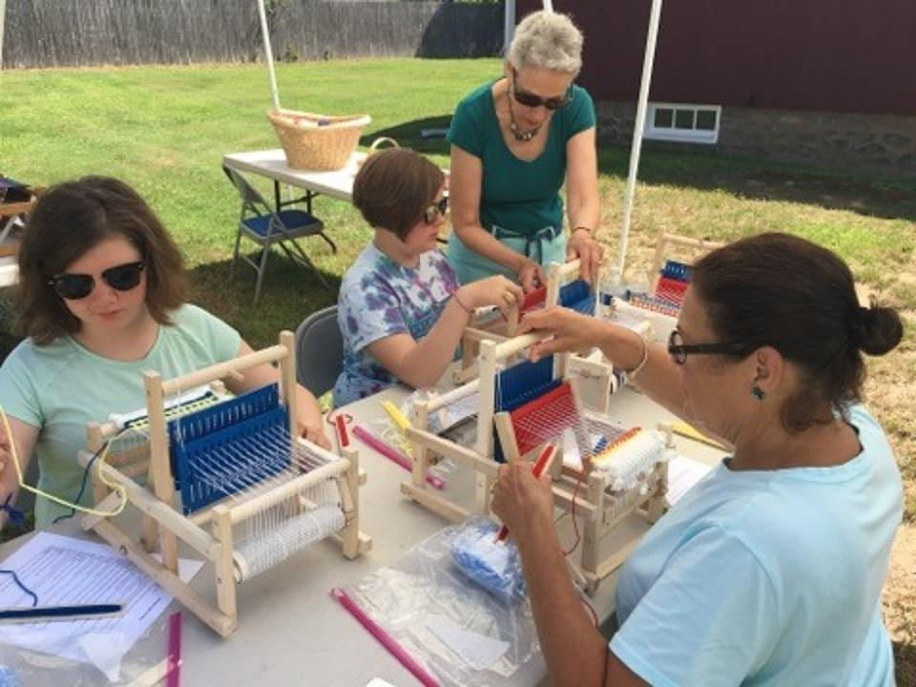
Advancing Our Mission:
Acquisitions
Advancing Our Mission:
Education & Programs
A
Annual
Barry Bergdoll was joined by other architects for a talk on “New Wave of Architecture on the North Fork” (July)
Weaving with Ellen Zimmerman (July & September)

Slide 13
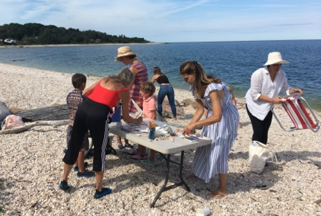
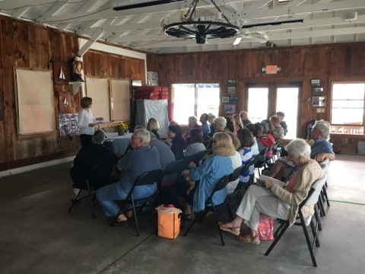
Advancing Our Mission:
Acquisitions
Advancing Our Mission:
Education & Programs
A
Annual
Bay to Table: Clams in Oysterponds (September)
What Do You Sea? Boat Building with Found Objects (August)

Slide 14
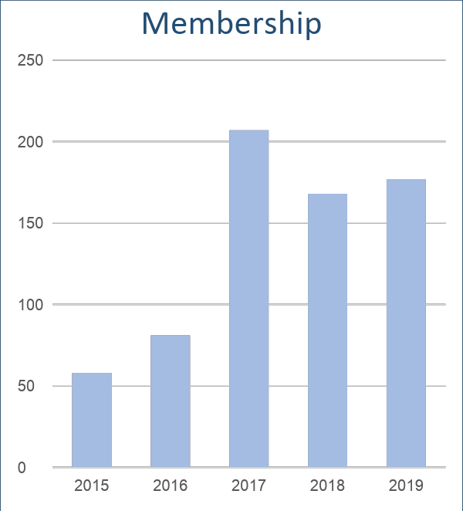
Advancing Our Mission:
Acquisitions
Supporting Our Mission:
Membership & Contributions
A
Annual
First Year for Griffin Giving Circle
Named for Augustus Griffin, Oysterponds’ eminent
nineteenth-century diarist and historian
7 Participants $35,000
$5,000 Donation Included:
Summer Benefit Patron ($1,000 included 4 tickets)
Benefactor Membership ($1,000)
North Fork Fresh Patron ($500 included 2 tickets)
Holiday Party Benefactor ($500 included 2 tickets)
Annual Fund Donation ($2,000)
In 2020, we will expand to 5 levels of
Griffin Giving Circles.

Slide 15
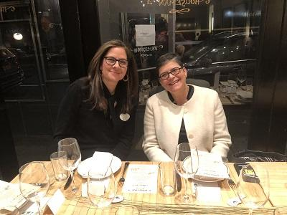
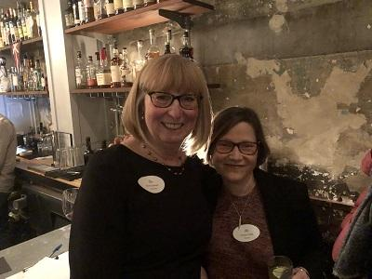
Advancing Our Mission:
Acquisitions
Supporting Our Mission:
Fundraising Events
A
Annual
A Night on the Town: Oysterponds Goes to Houseman
56 Guests
8 Raffle Donors
Net Income $7,160

Slide 16

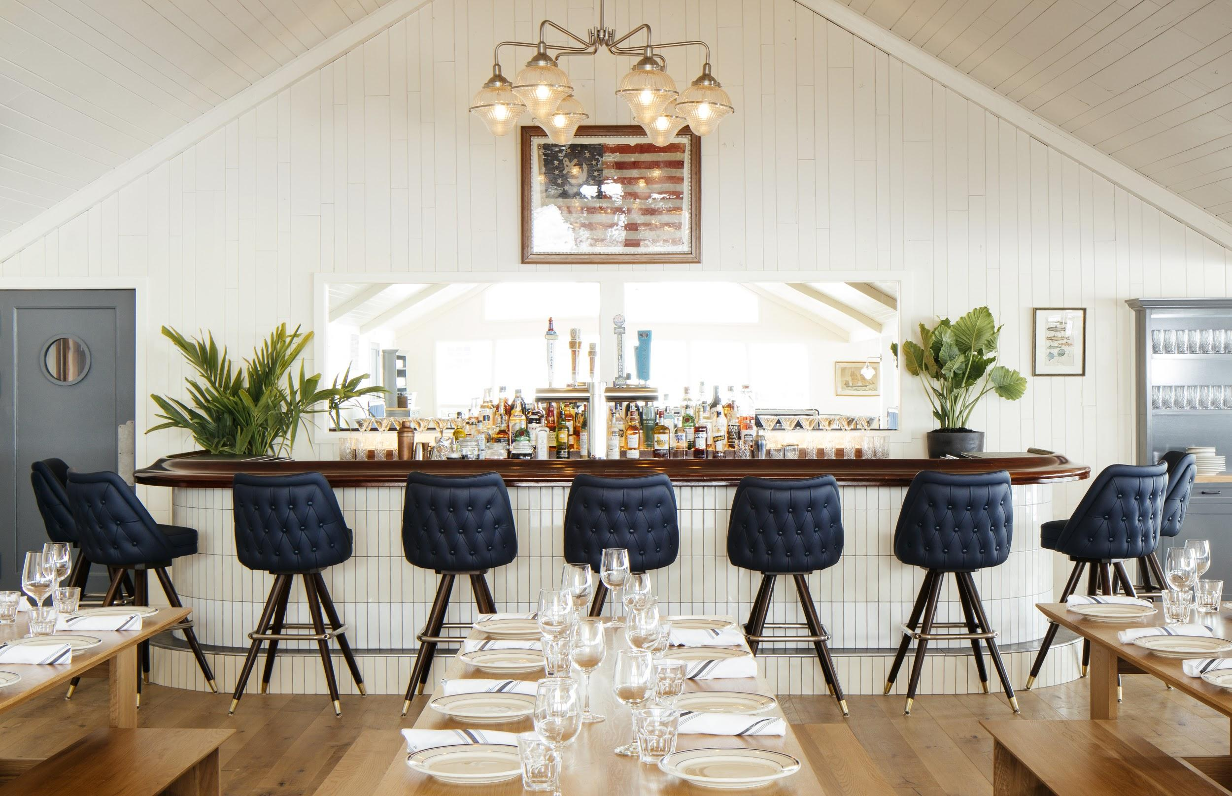

Advancing Our Mission:
Acquisitions
Supporting Our Mission:
Fundraising Events
A
Annual
Countdown To Summer at
140 Guests
Net Income: $3,050

Slide 17
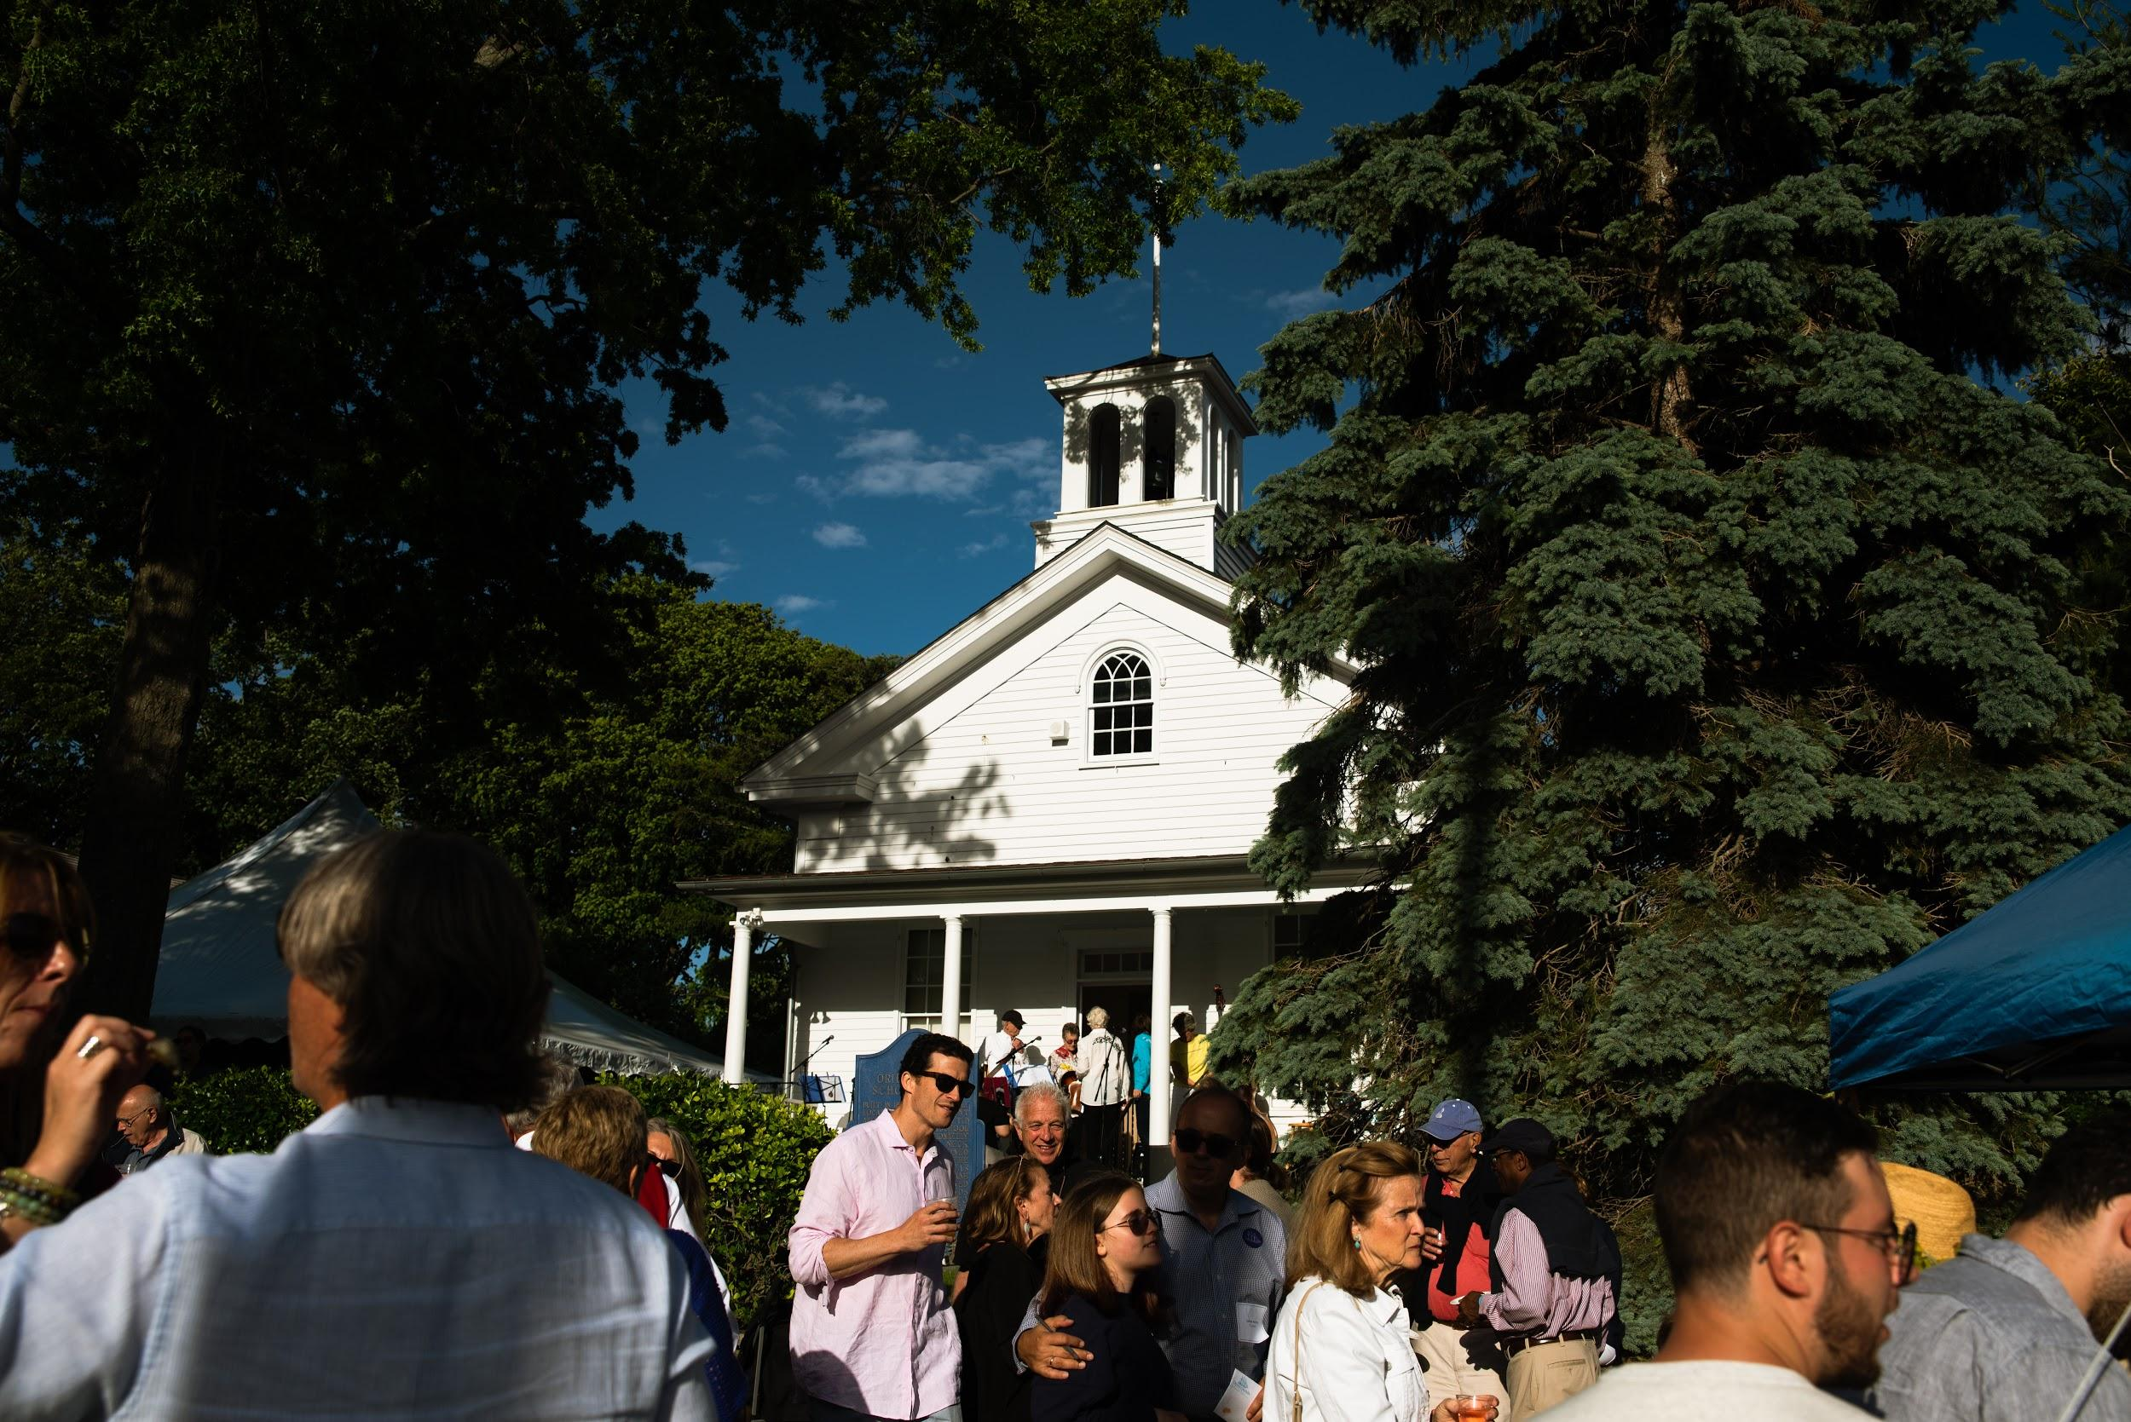

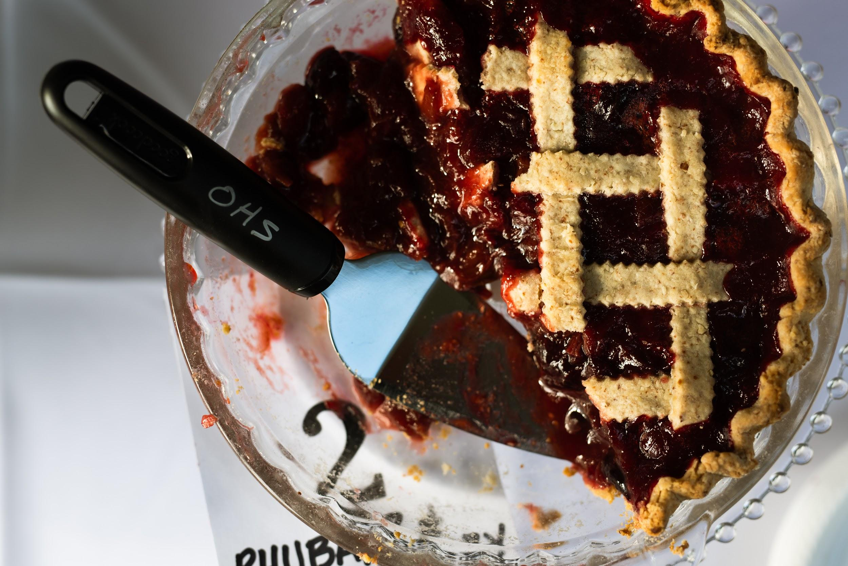
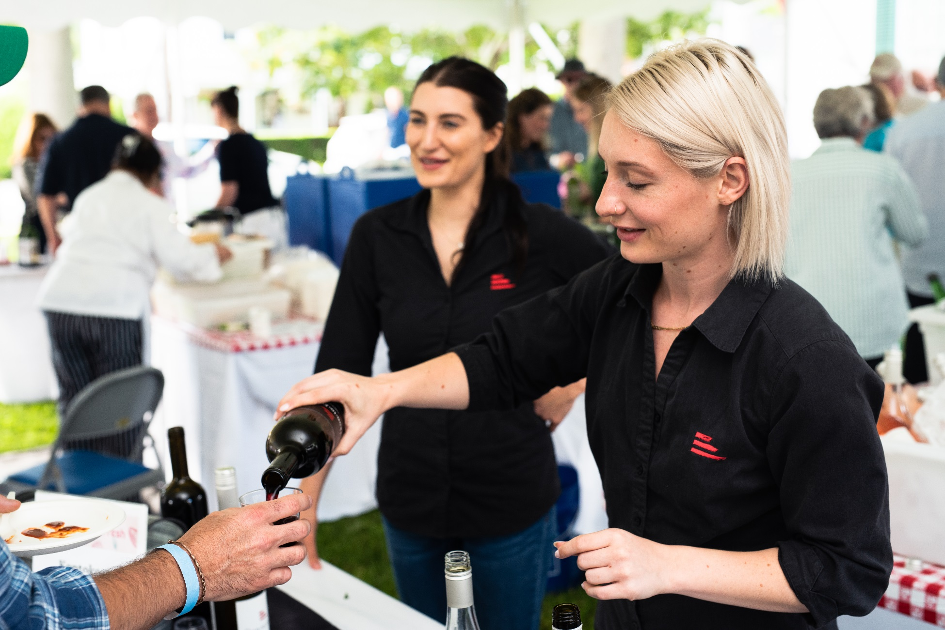
Advancing Our Mission:
Acquisitions
Supporting Our Mission:
Fundraising Events
A
Annual
300 Guests
24 Vendors
47 Raffle Donors
Net Income: $23,068

Slide 18
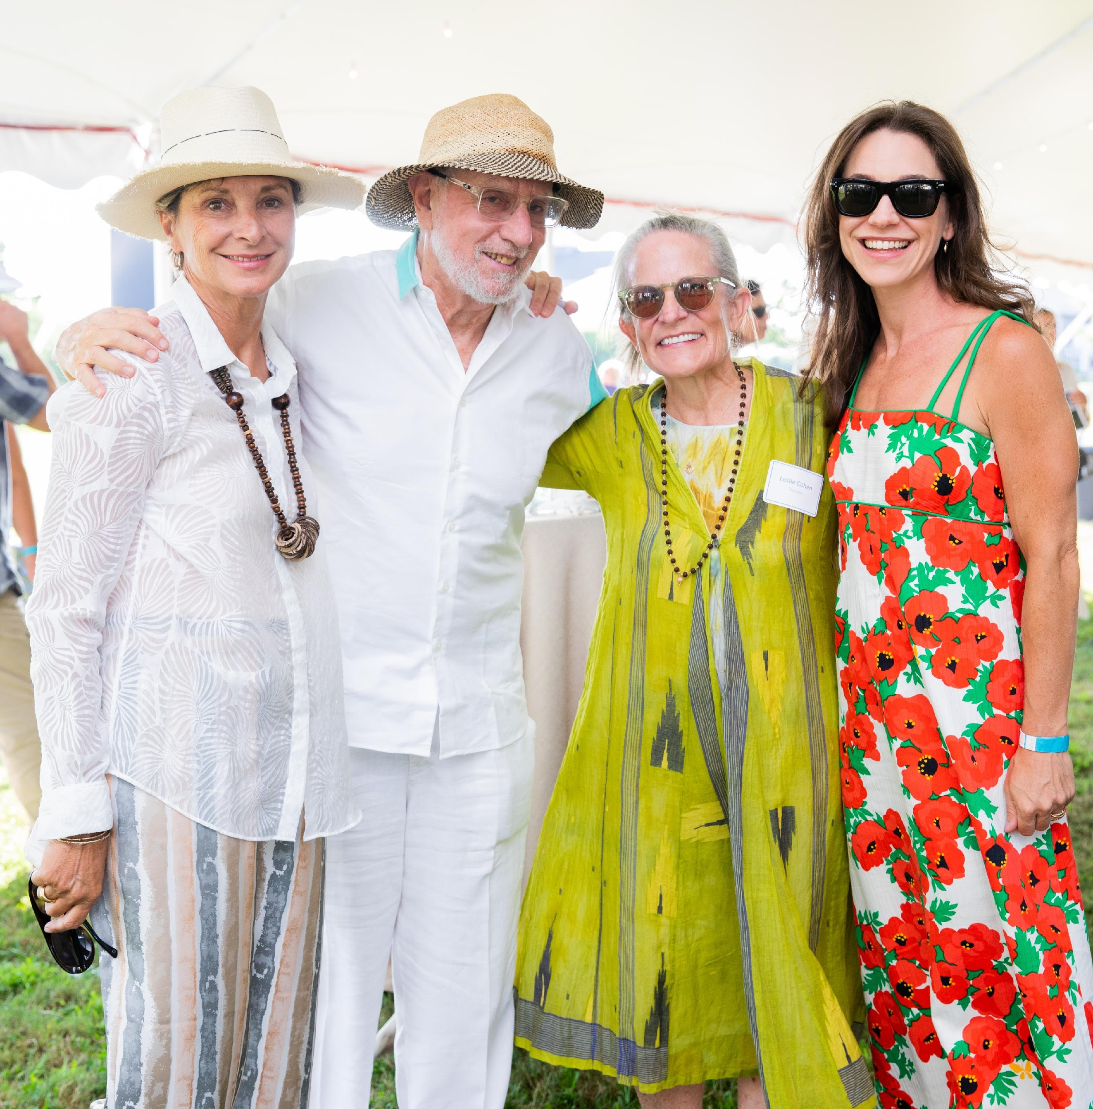
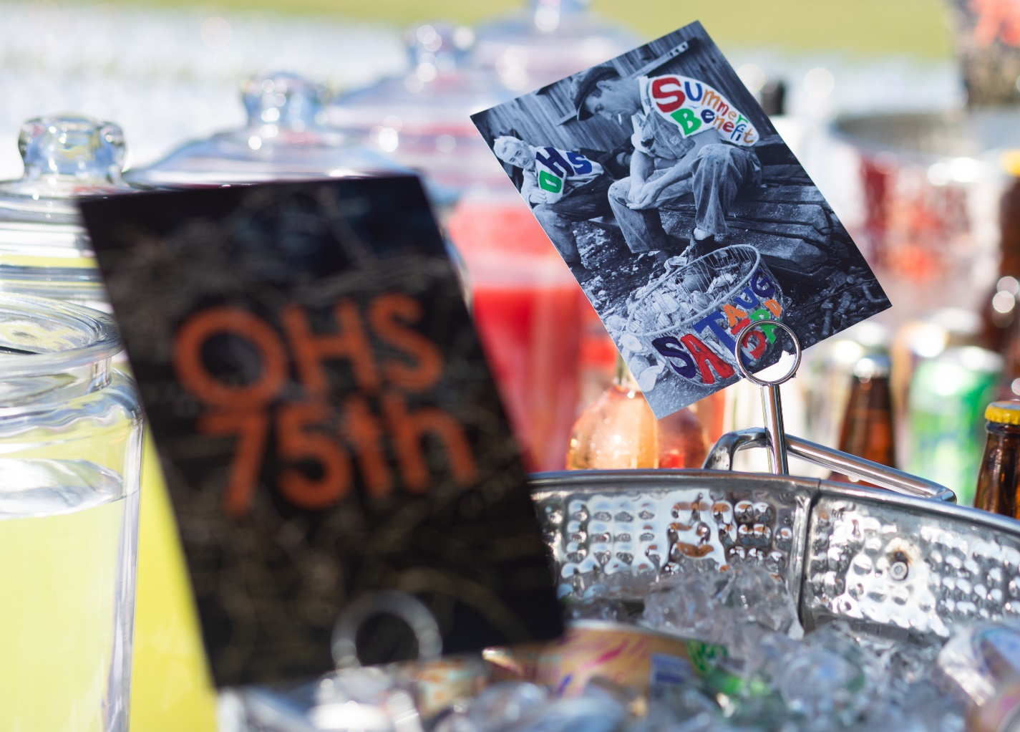
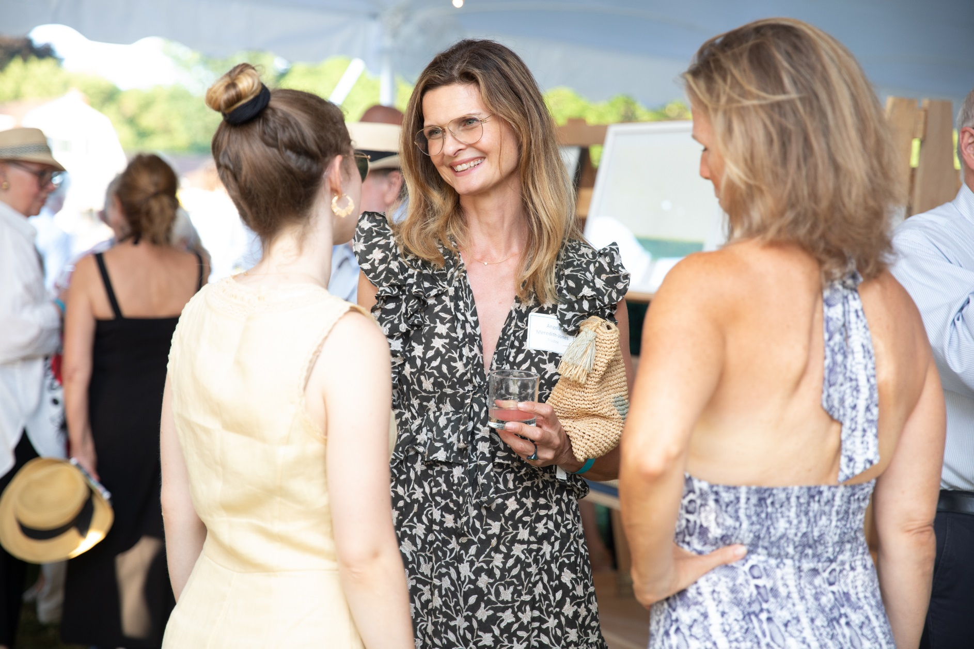
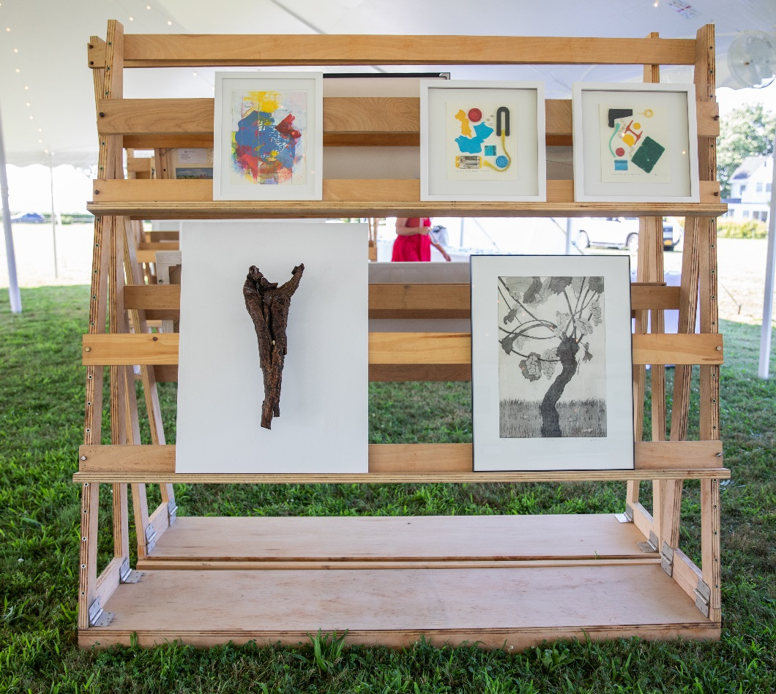
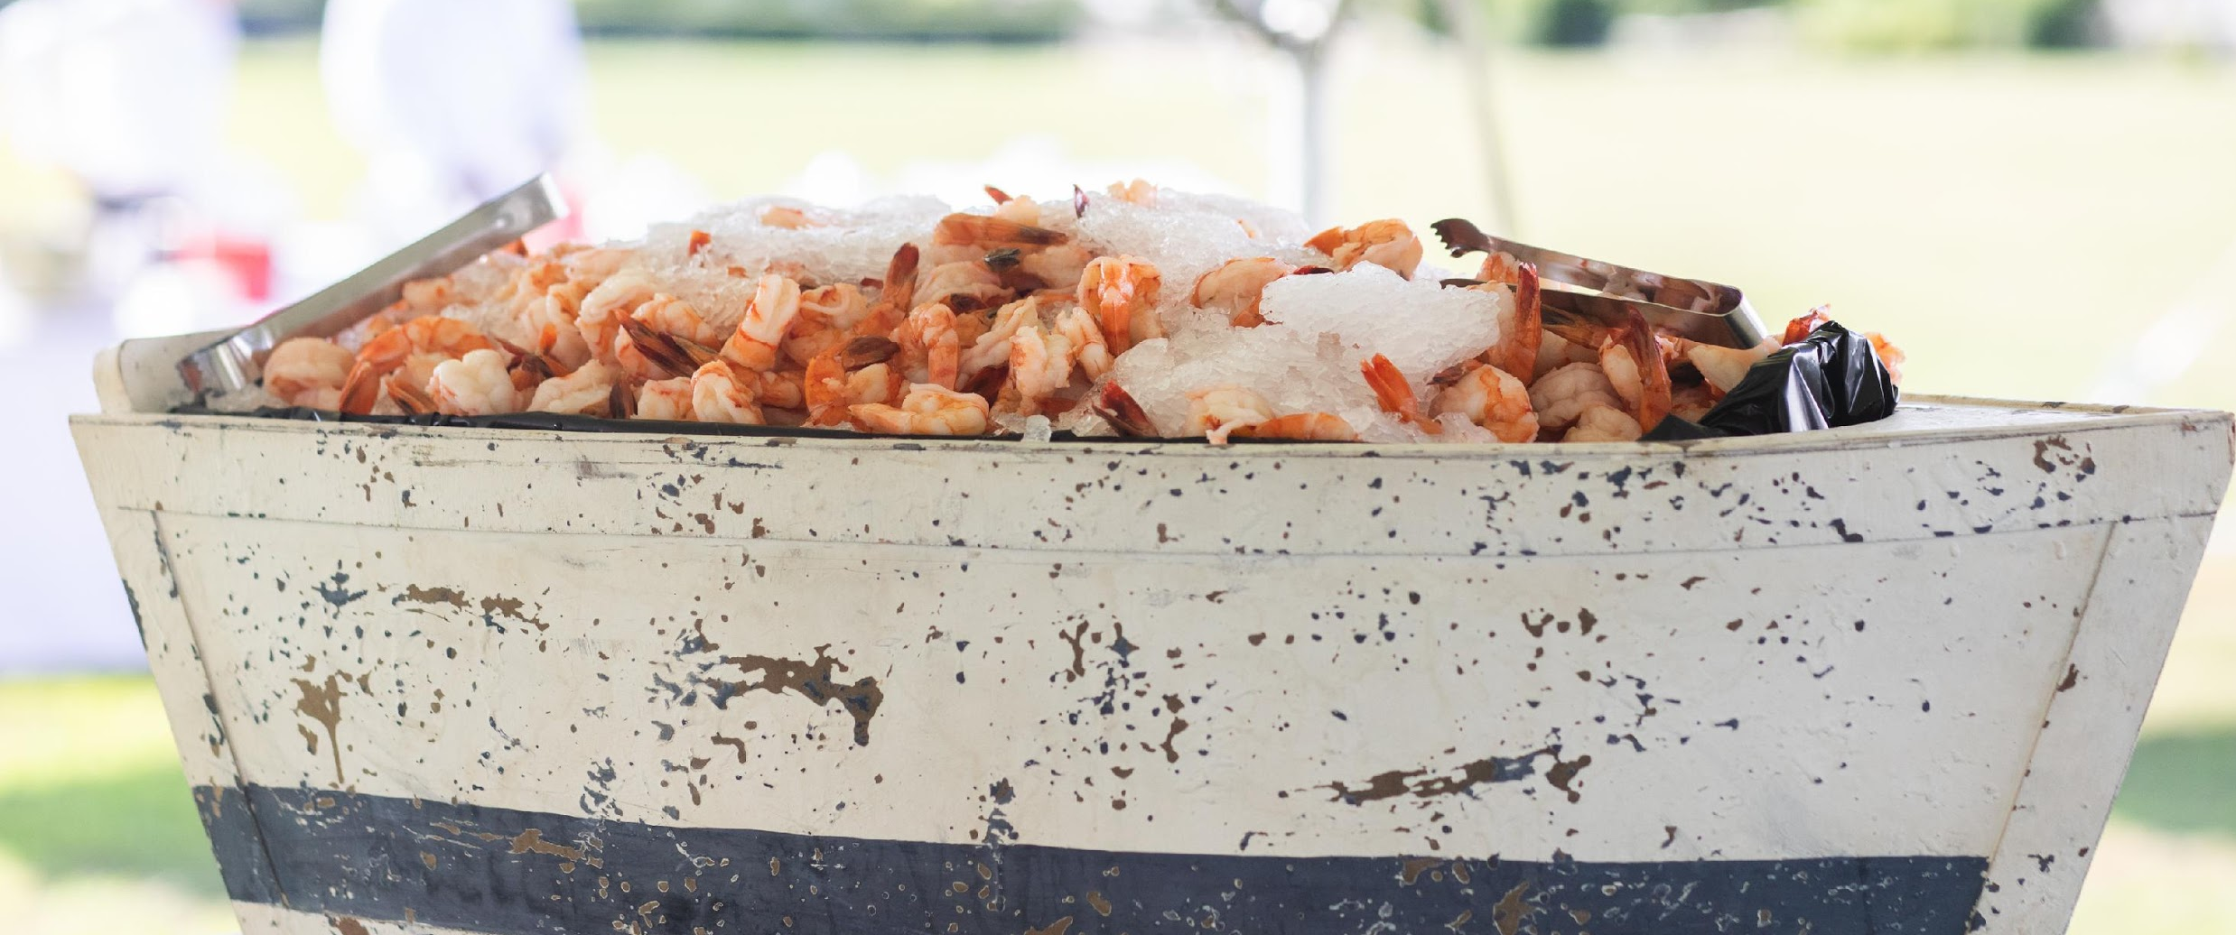
Advancing Our Mission:
Acquisitions
Supporting Our Mission:
Fundraising Events
A
Annual
Summer Benefit and Art Auction
350 Guests
49 Works of Art
Net Income:
$118,061

Slide 19
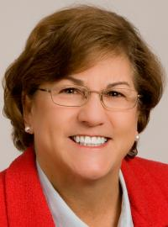
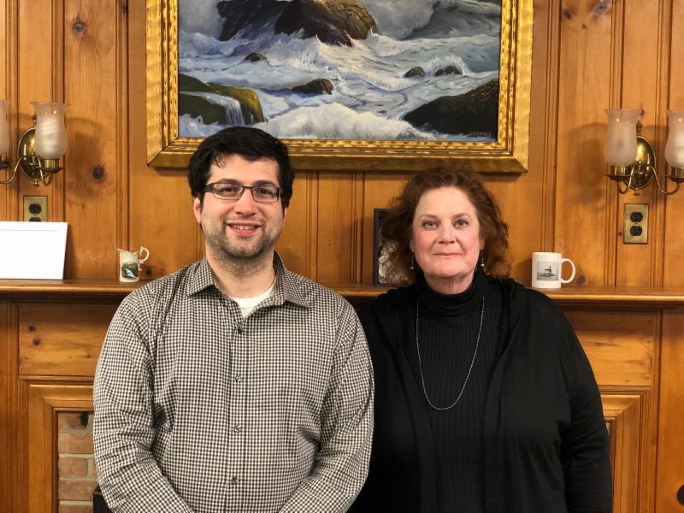
Other OHS News
New Faces
In 2019, new staff members joined Amy Folk and Bill McNaught.
Sarah Sands replaced Marianne Howard as Executive Director.
Matthew Montelione joined as External Affairs Manager.
Terri Sweeney joined as Office Manager.

Slide 20
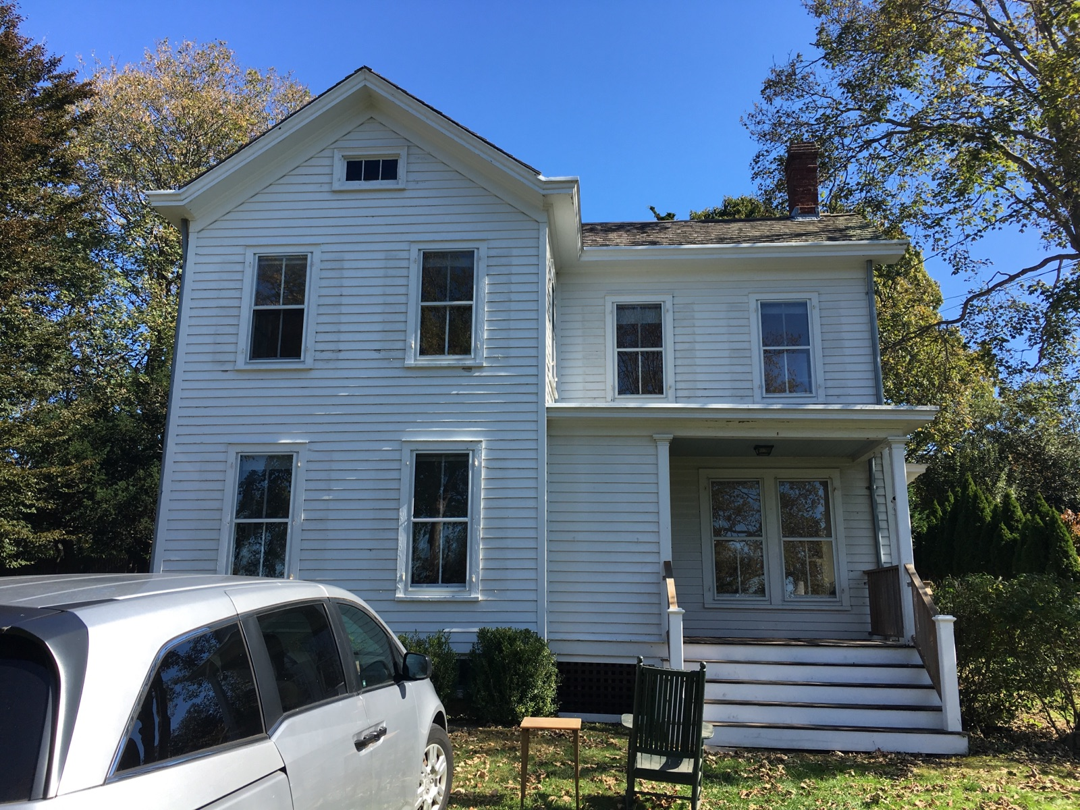

OHS Offices Moved to
Vail House!
IT Services Moved to Cloud-Based

Slide 21
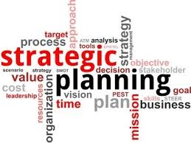
LOOKING AHEAD
2020
A
Annual
STRATEGIC GOALS:
Broaden and deepen our engagement with the local community:
Engage diverse audiences through exhibitions, programs, and community partnerships
Use of local expertise and talents to create opportunities to learn about North Fork history and culture, particularly Oysterponds
Manage collections care and growth and increase accessibility of collection:
Practice responsible stewardship by managing collection care and growth.
Make the collection available to the public through digitization.
Maintain Optimal Use and Condition of Facilities and Grounds:
Plan for maintenance, restoration, preservation and use of the OHS campus
Provide comfortable access and amenities for the public, staff, and volunteers
Safe and secure storage and exhibition space for the collection
Ensure that our growing programming space needs are met.
Build Capacity to Achieve Strategic Plan Goals:
Ensure the financial & human resources that are necessary to the pursue organizational mission and goals.

Slide 22
Thank You to our 2019 Trustees!
Ed Caufield, Co-President
Leslie Koch, Co-President
Ann ffolliott, Vice President
Allison Forstmann, Treasurer
Karin Constant, Secretary
Christine Churchill
Leslie Cohen
Jeffrey Davis
Suzanne Gluck
Robert Hanlon
James Harris
Lydia Irving
Angela Meredith-Jones
Stephen Rotella
Sandra Saiegh
Howard Shainker
Diana Whitsit
Ellen Zimmerman
Fredrica Wachsberger, Emerita

Slide 23

THANK YOU to our Valuable Volunteers.
Oysterponds Historical Society could not exist and thrive without you.
175 Volunteers gave
Time and Talent and Resources in 2019.
Exhibitions, Docents, Tours and Education
Audit, Collections, Buildings & Grounds, Education, Programs & Committees
Special Events & Fundraising
Independent Sector.org Annual Volunteer Hour Valuation at $25.43 hour

